Slide 1
Introduction to Computing for Data Analysis
Linear regression
Richard Vuduc, Ph.D.
Associate Professor
School of Computational Science and Engineering
Minimizing the residual
Notes:
In the last lesson, we motivated and formulated the mathematical problem of linear regression.
In this lesson, let’s figure out what we need to do computational to fit the parameters of a linear model.
We’ll start with the single-response, single-predictor model, and consider the multiple-predictor case in the next lesson.

Slide 2

Notes:
Recall the setup:

Slide 3
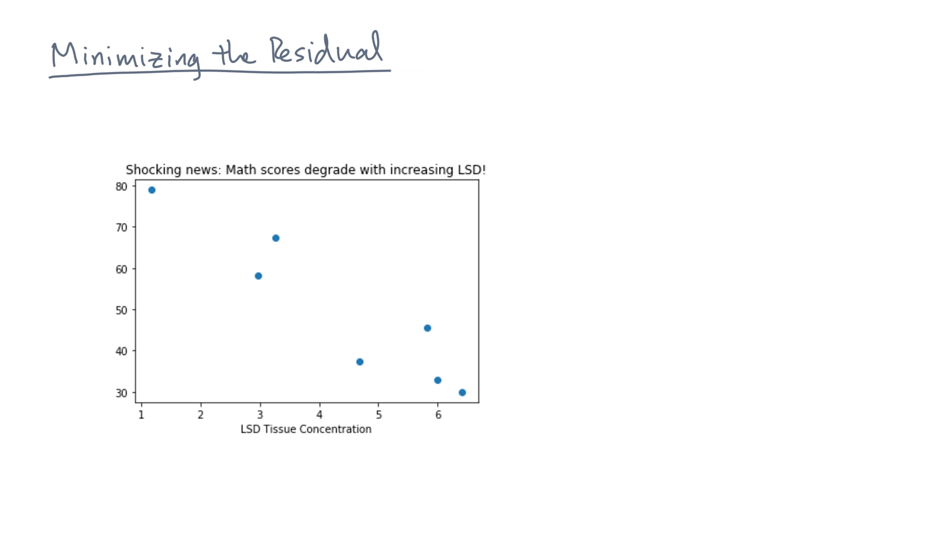
Notes:
Suppose you are given a single-predictor, single-response dataset.

Slide 4
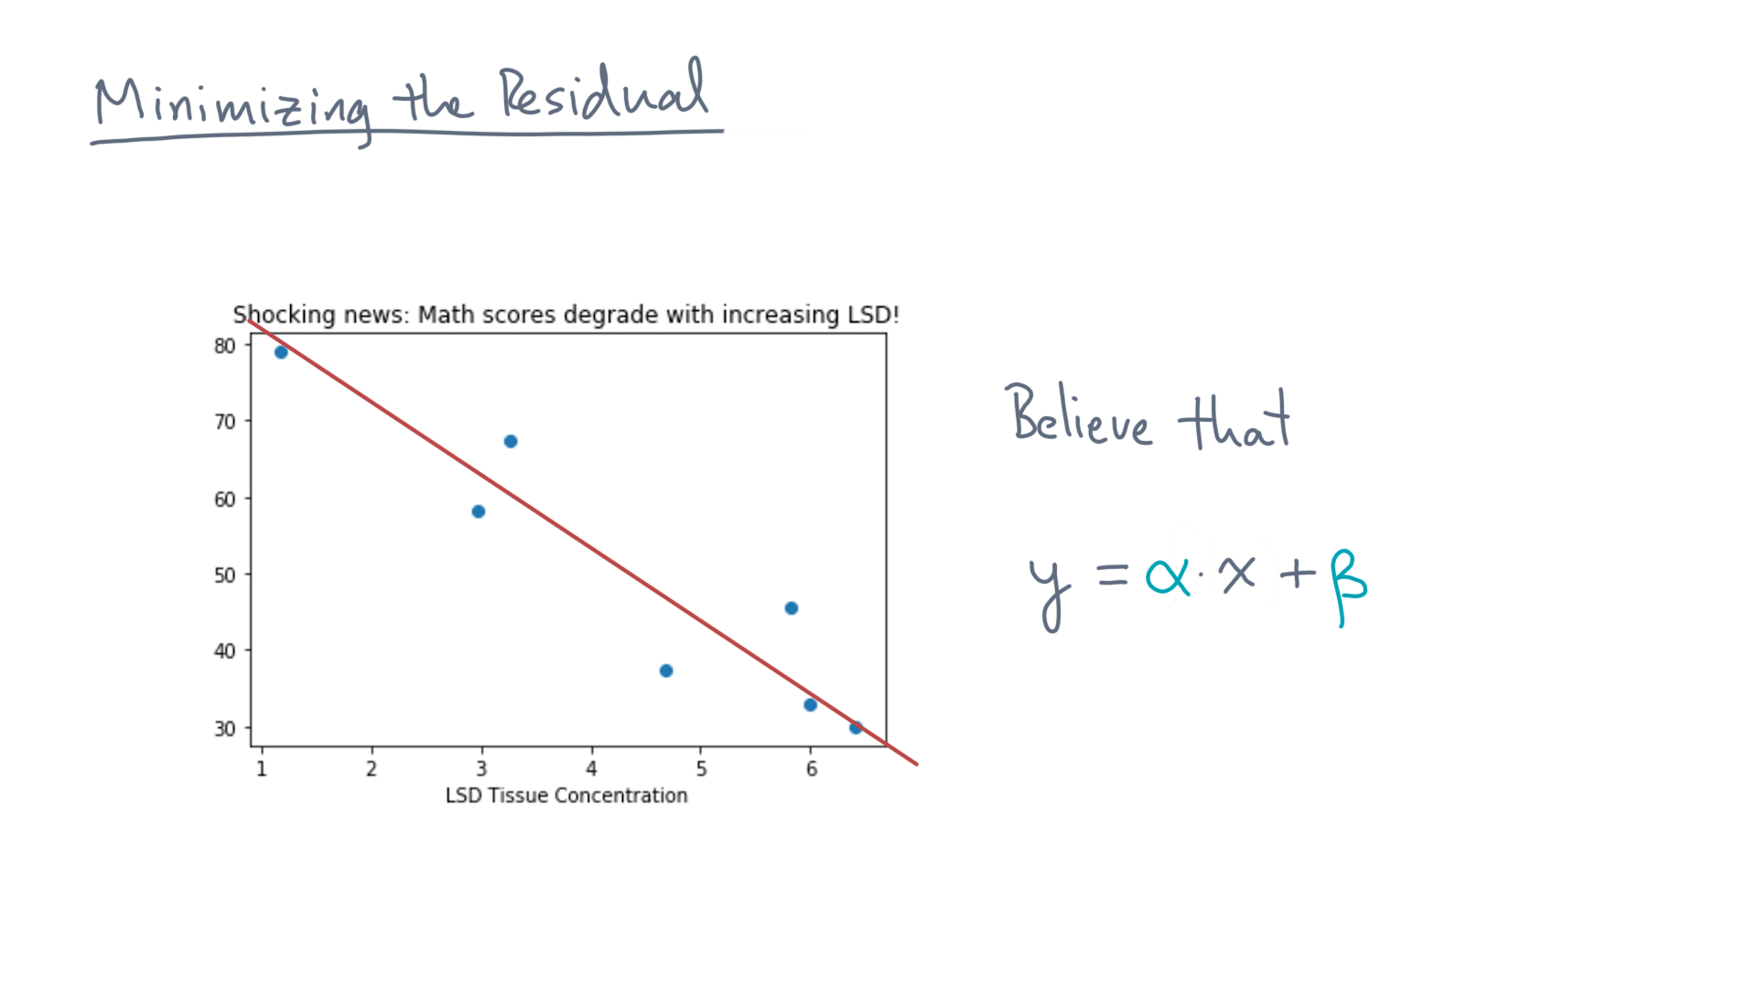
Notes:
And let’s say you also think a line is a good mathematical model for it.

Slide 5
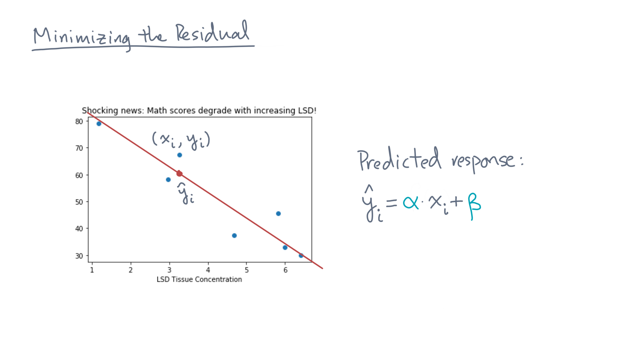
Notes:
For each point, x-eye, y-eye, this model generates a prediction, y-eye-hat.

Slide 6
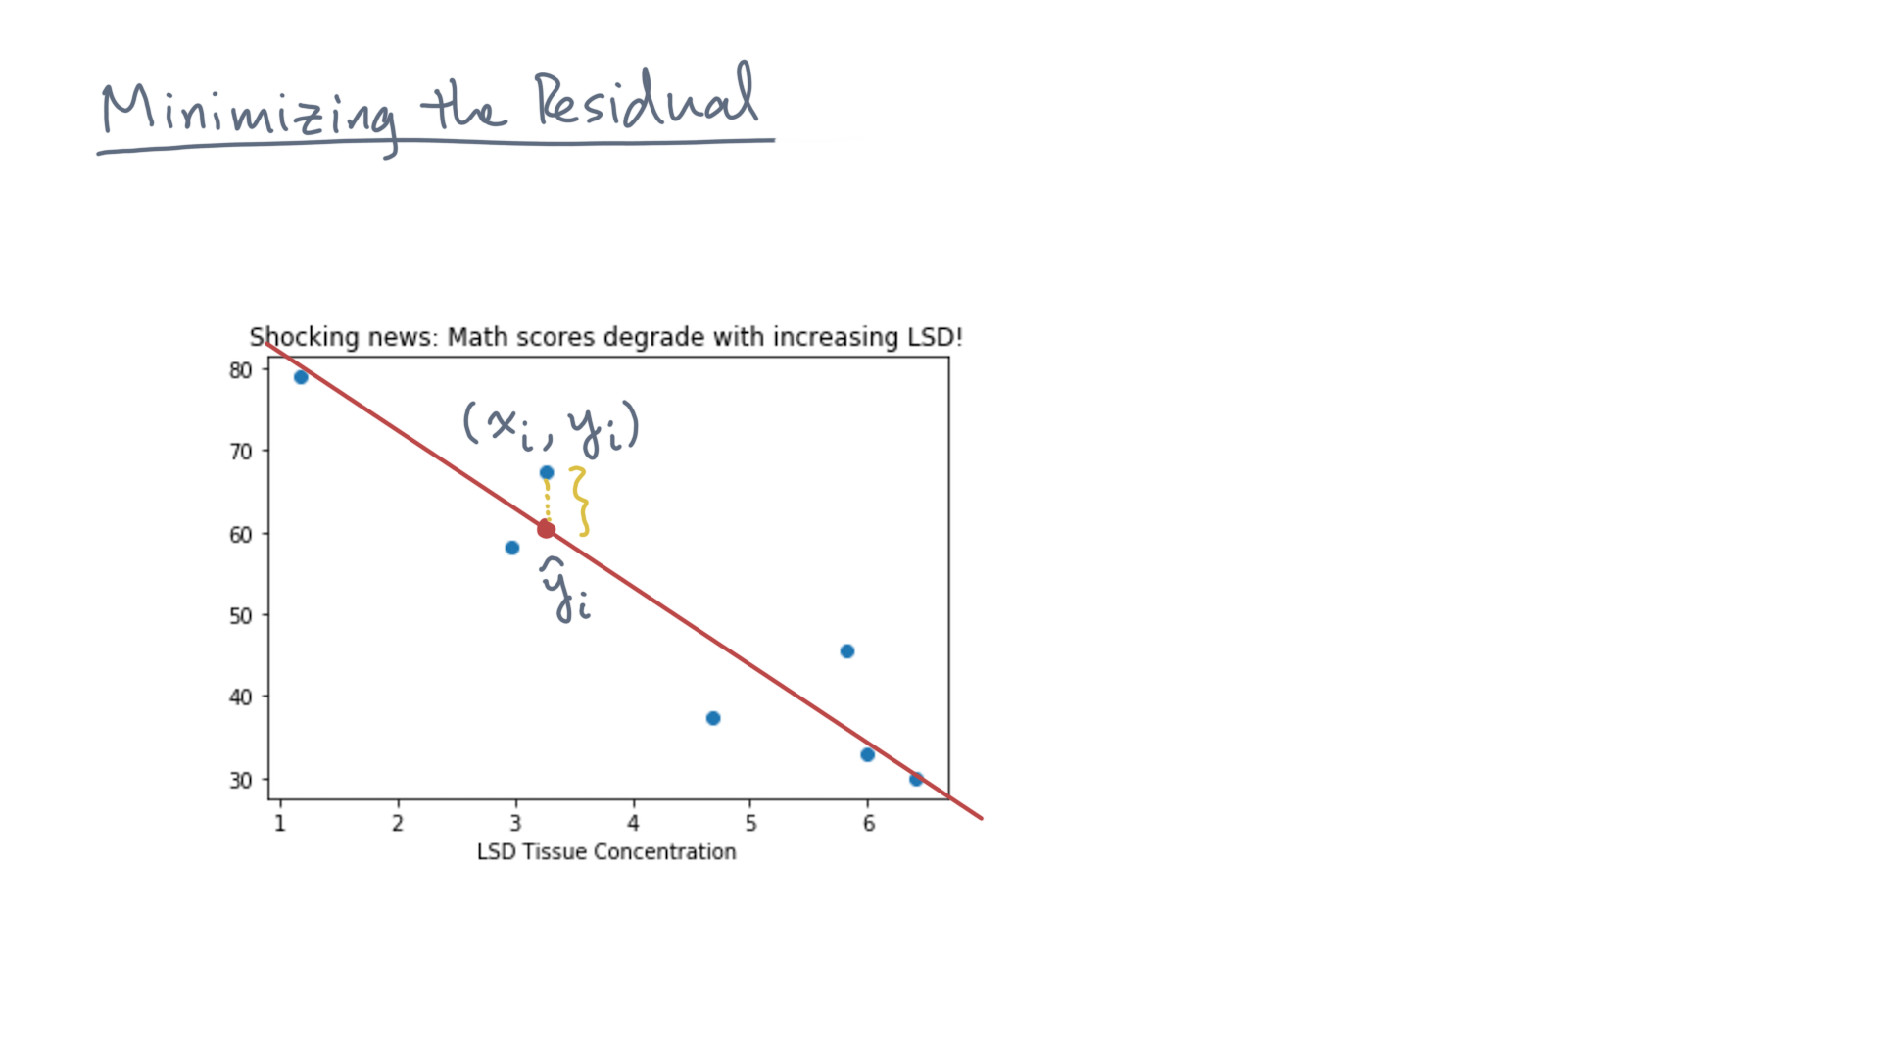
Notes:
Now consider the difference between the prediction, y-eye-hat, and the observation, y-eye.

Slide 7
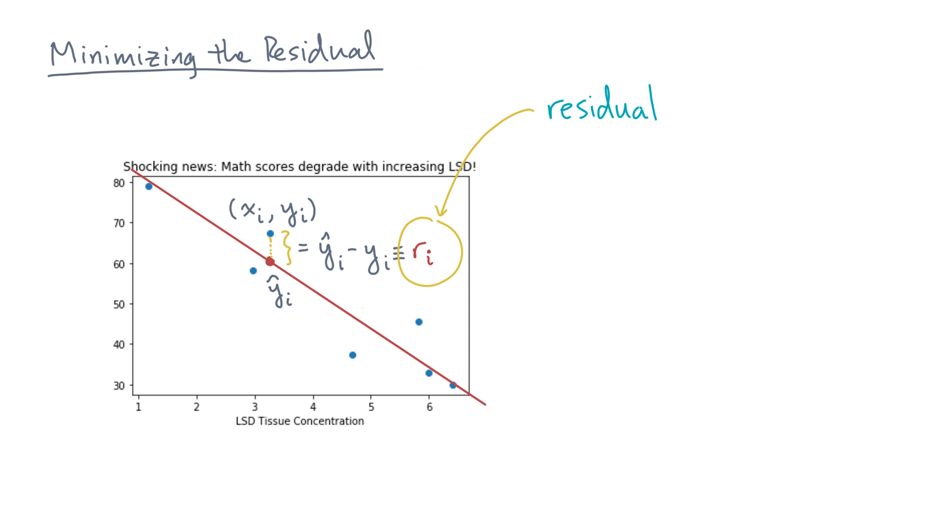
Notes:
Let’s call that difference the residual at x-eye.

Slide 8
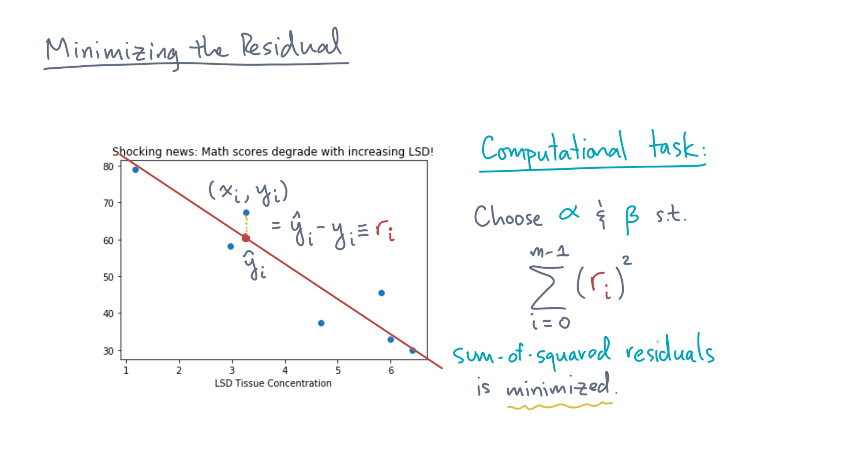
Notes:
We then said our computational task was to minimize some function of this difference, such as the sum-of-squared residuals over all points.

Slide 9
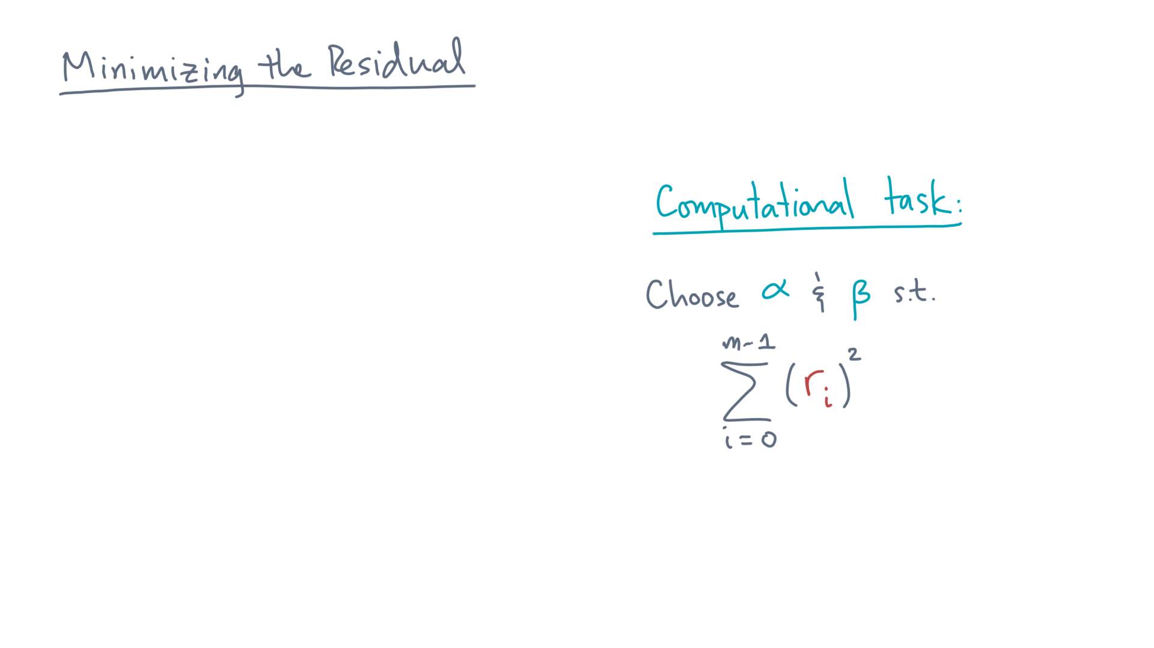
Notes:
So let’s turn our attention to this computational problem.

Slide 10
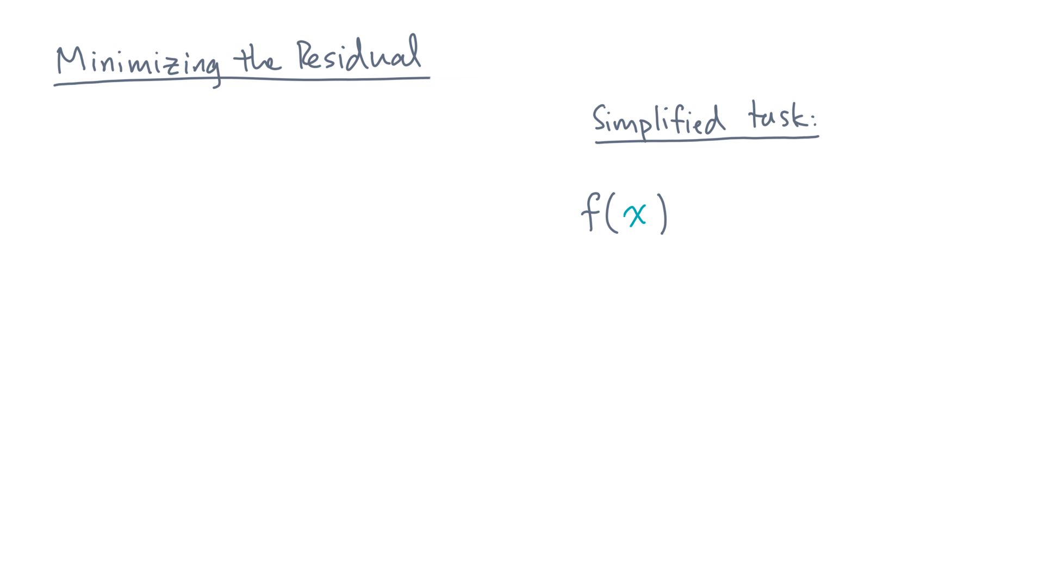
Notes:
To build your intuition, let’s start with a simpler function, f(x).
And let’s say it’s quadratic in x.

Slide 11
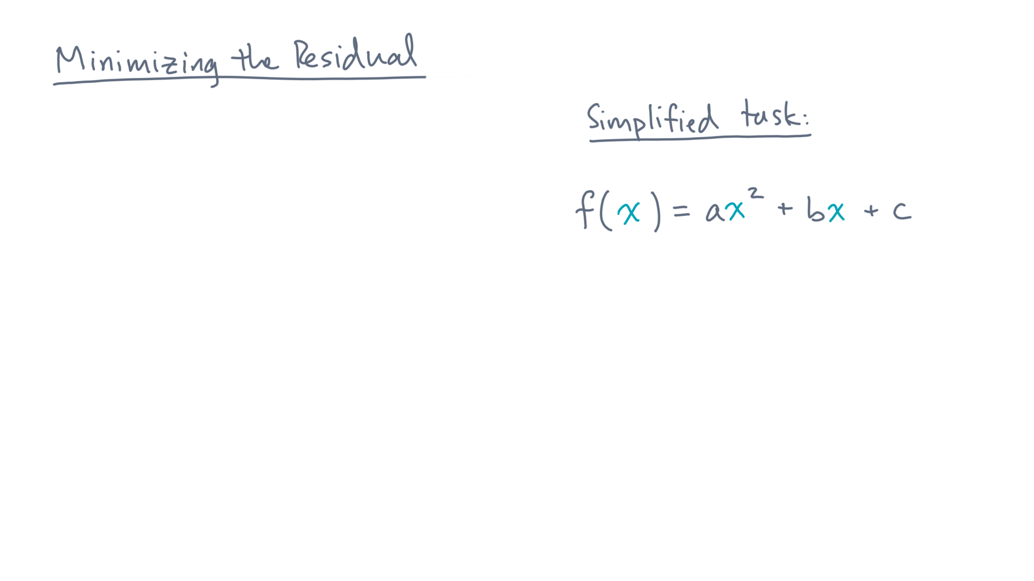
Notes:
That is, a times x squared plus b times x plus c.

Slide 12
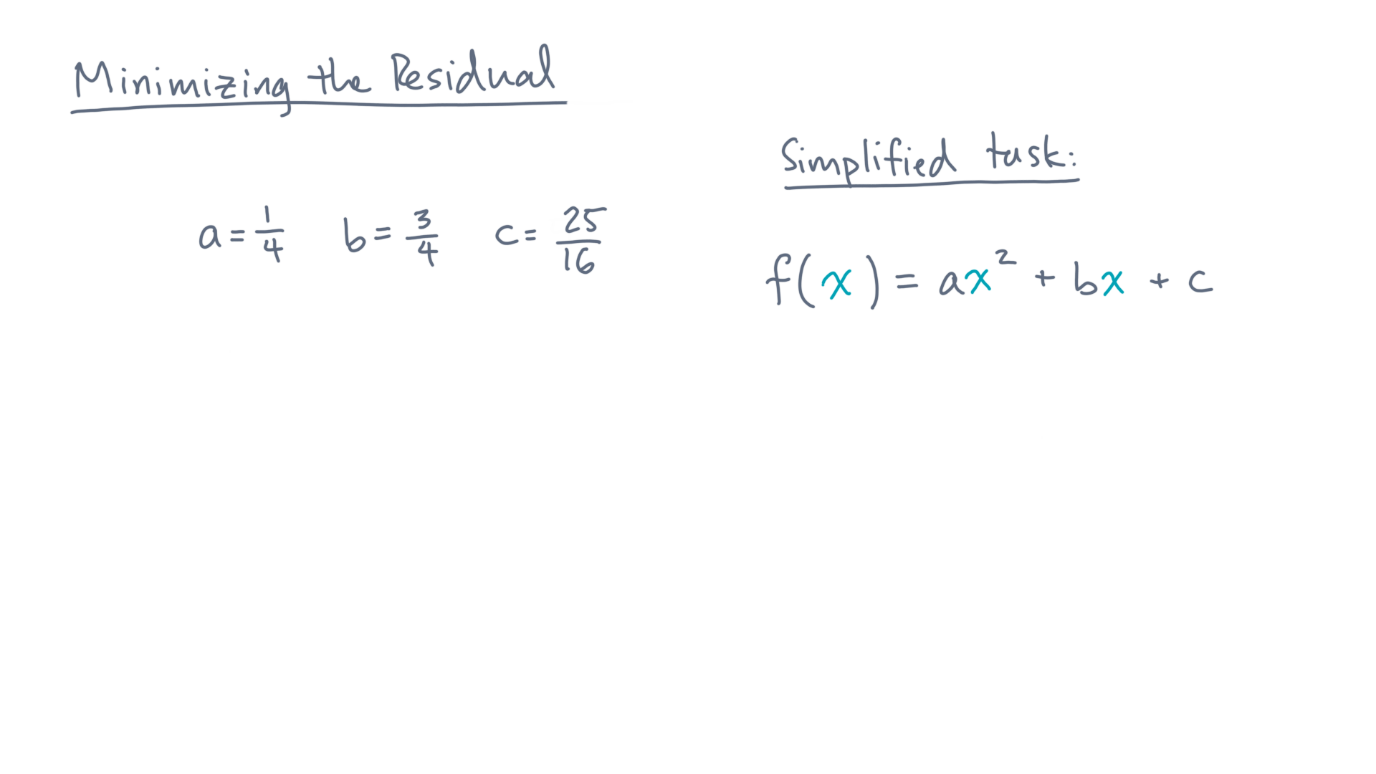
Notes:
Let’s choose some values for these coefficients, like a equals ¼, b equals ¾, and c=25/16.

Slide 13
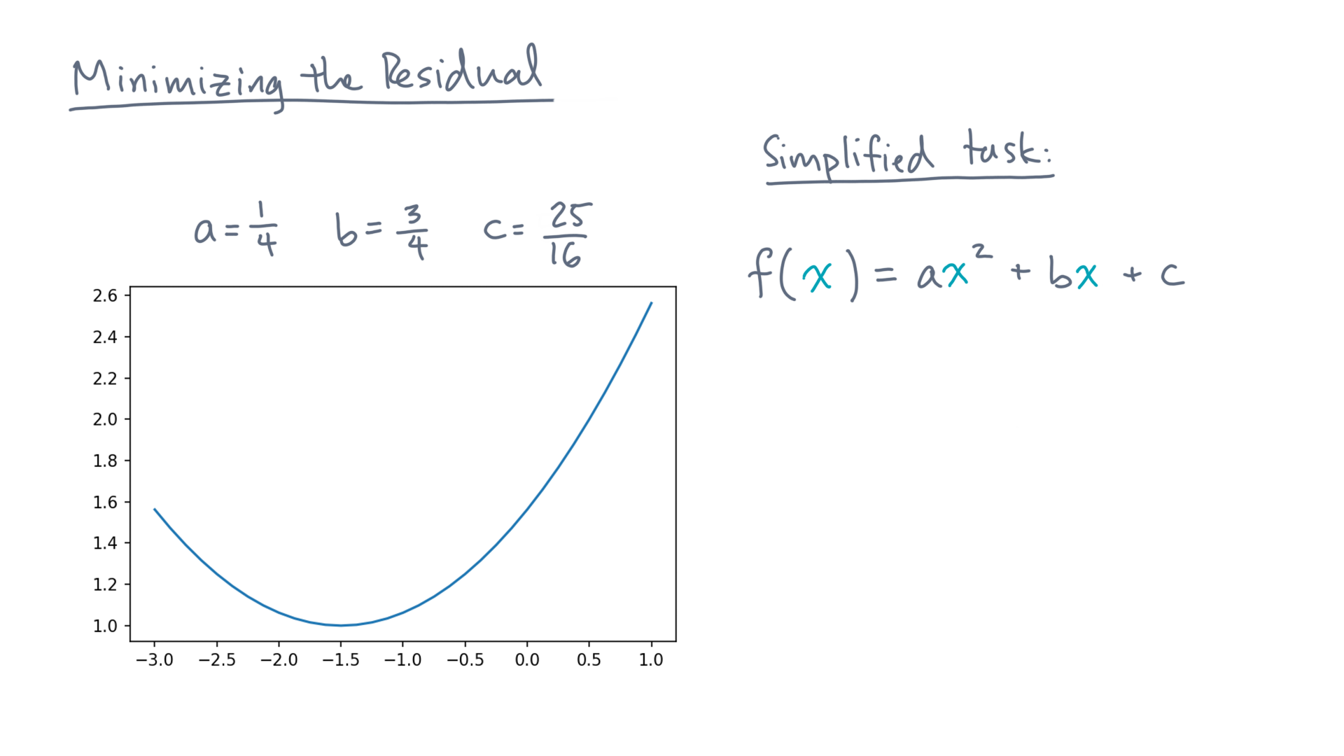
Notes:
Then the function is parabola, like this one.
So how would you find its extreme points, that is, the locations of its minimum or maximum values?

Slide 14
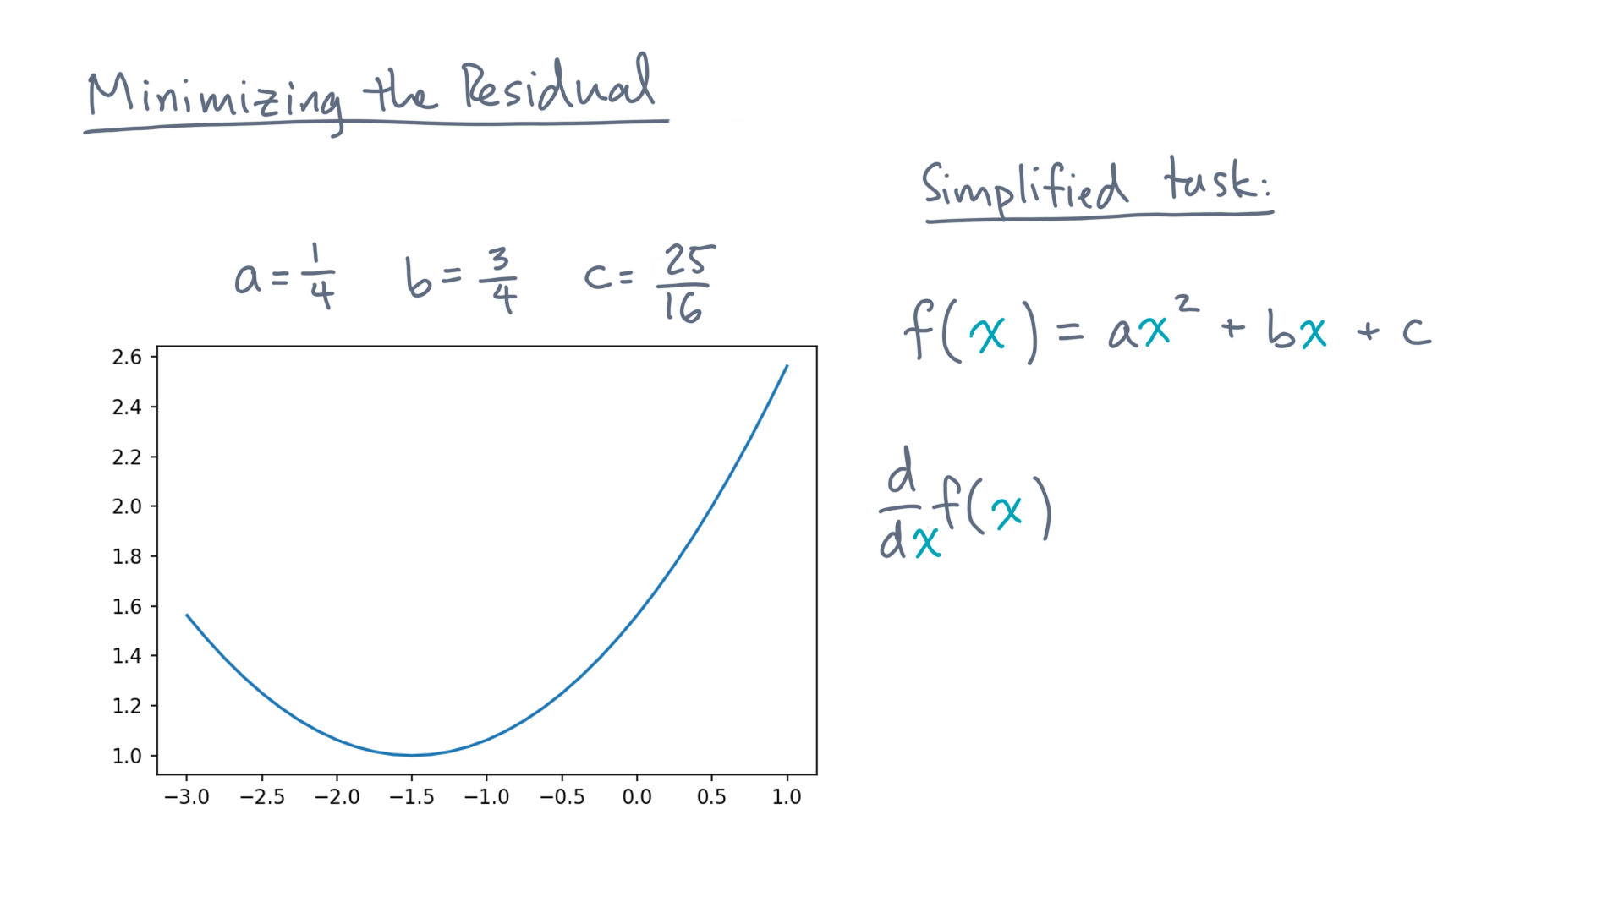
Notes:
Recall from calculus 101 that you’d start by computing the function’s first derivative.

Slide 15
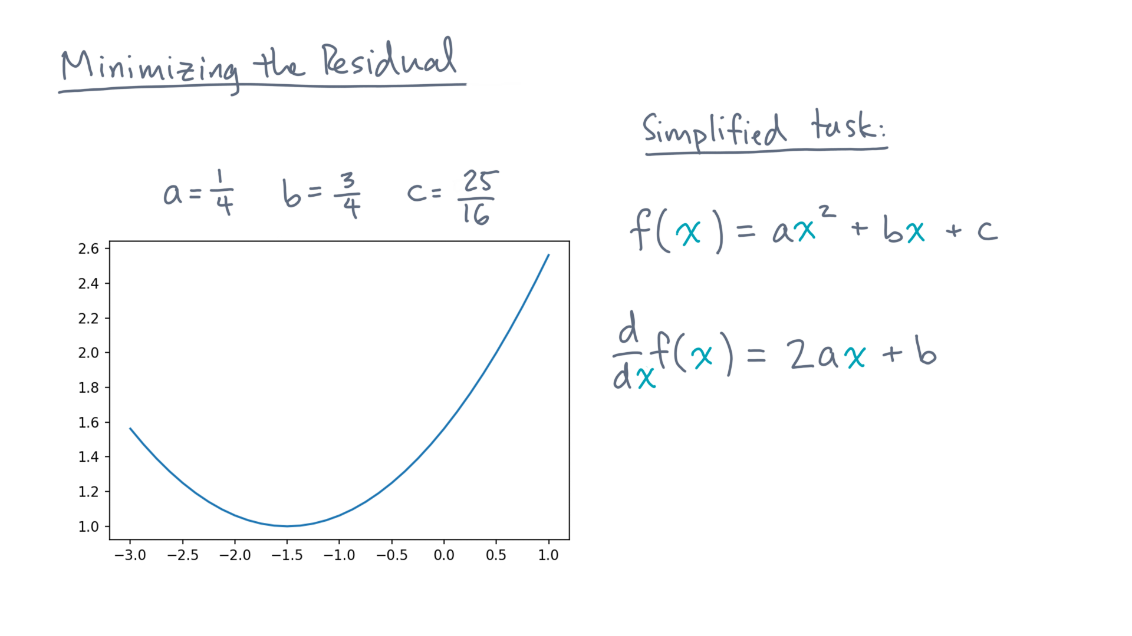
Notes:
In this case, that’s 2 times a times x plus b.

Slide 16
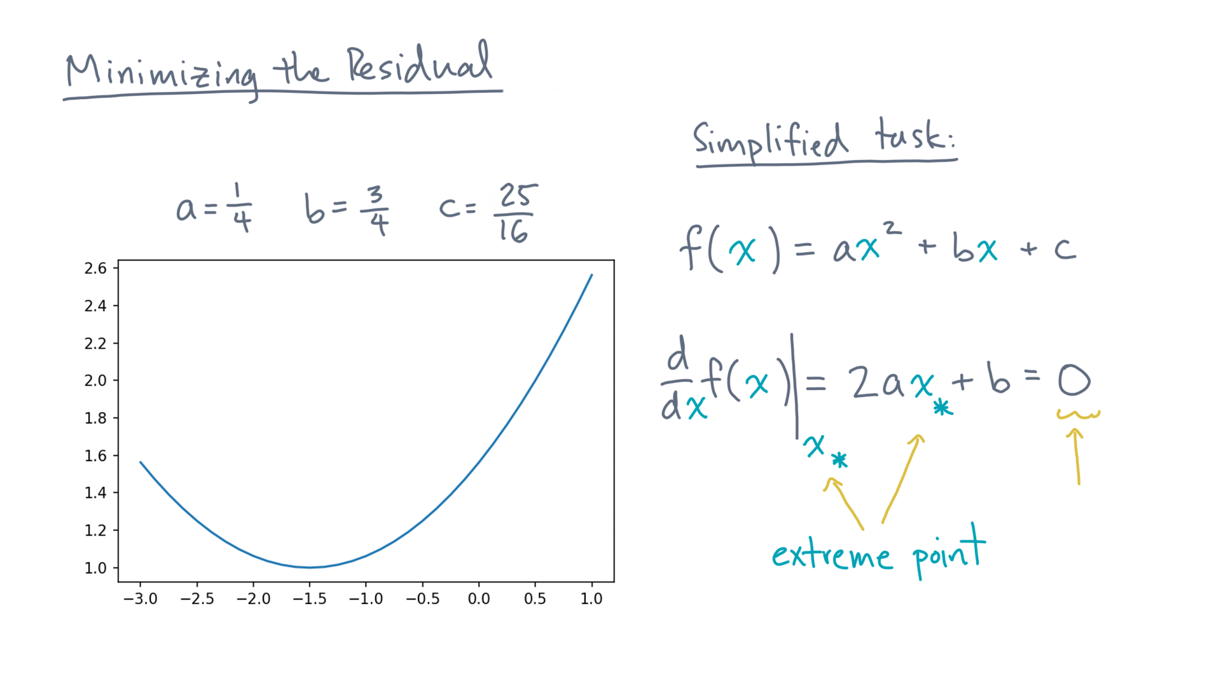
Notes:
At an extreme point, x-star, the first derivative is identically zero.

Slide 17
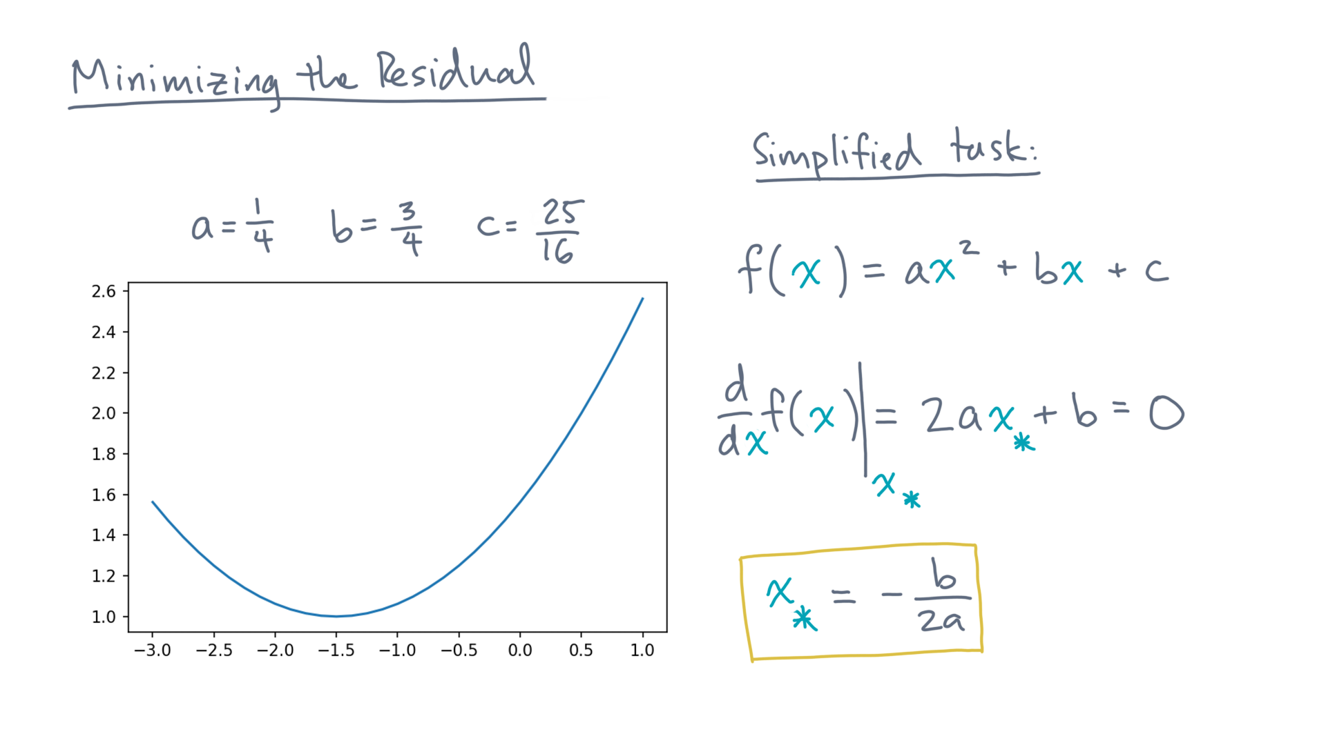
Notes:
Solving for x-star, you’d get this result: minus b divided by 2 a.

Slide 18
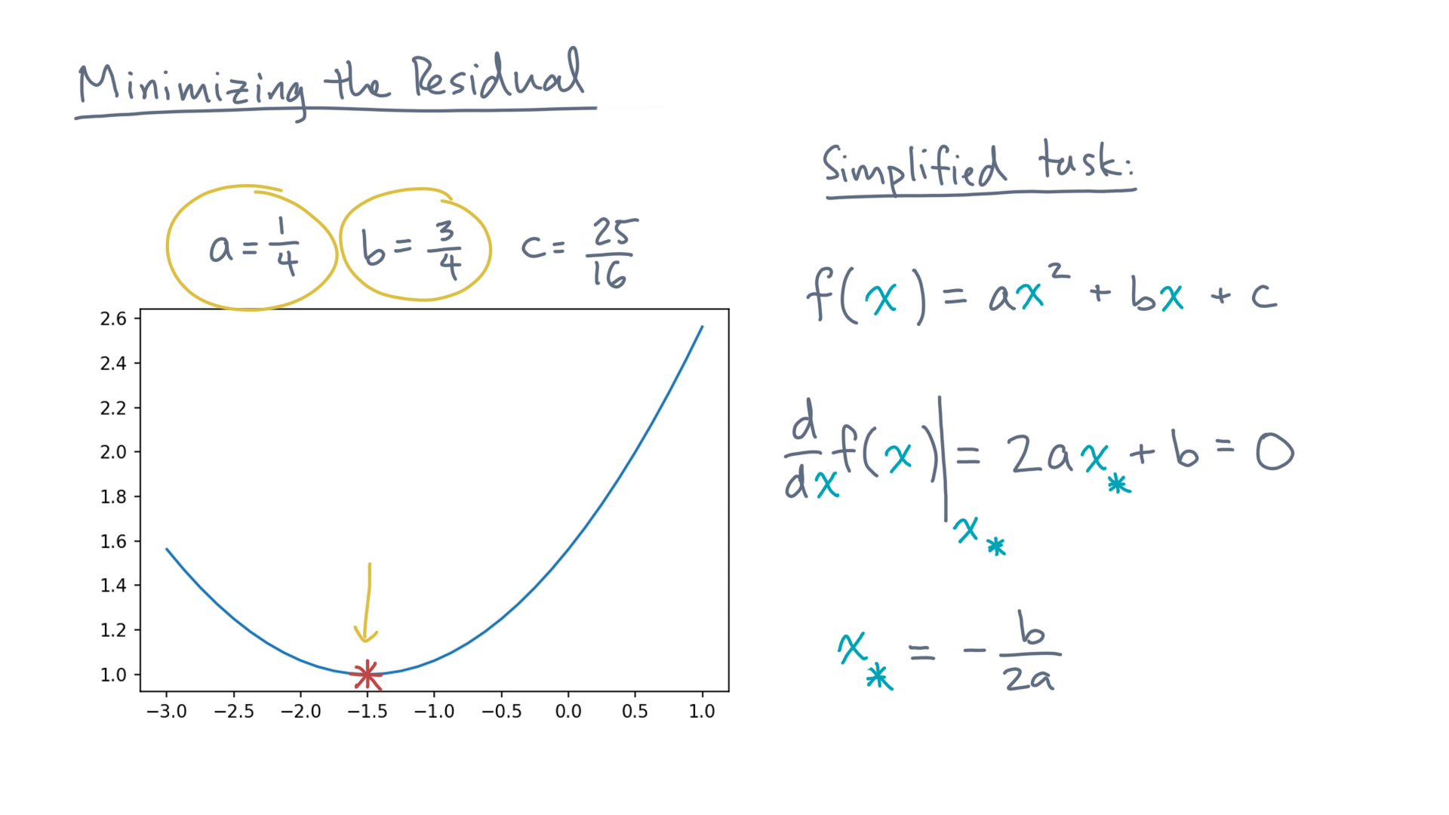
Notes:
In this example, that’s the point x-star equals minus 1.5.

Slide 19
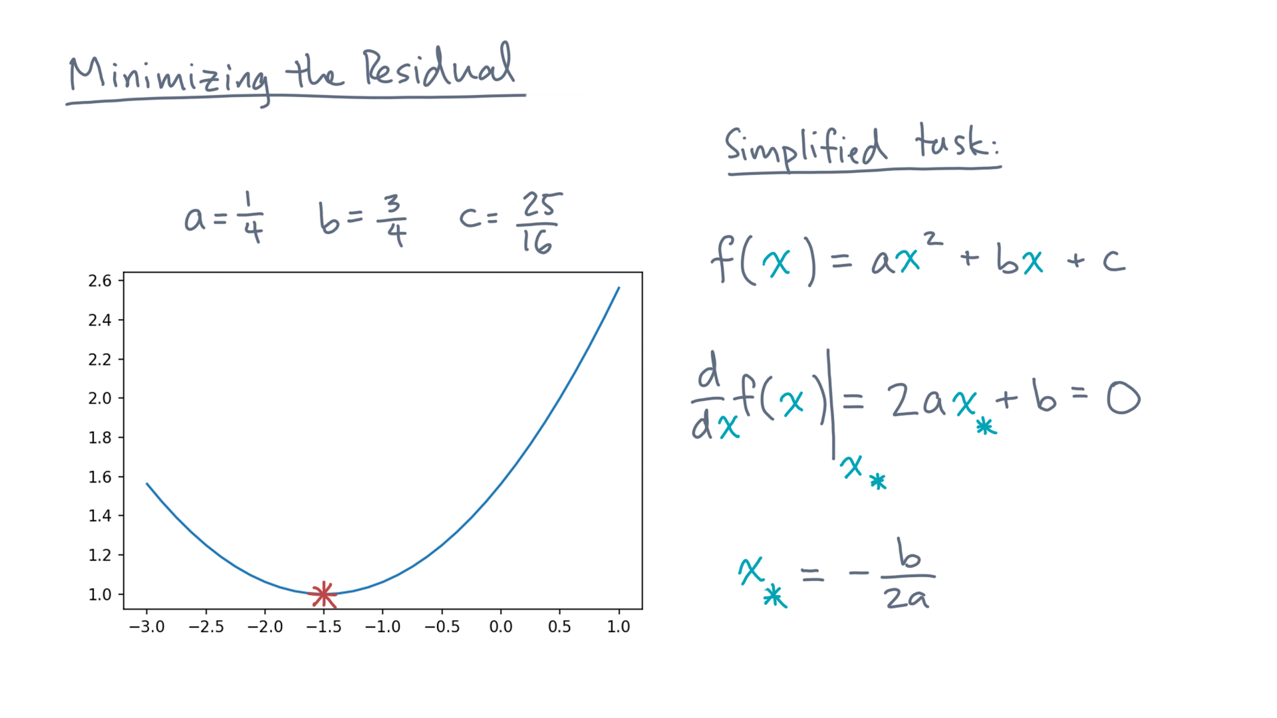
Notes:
Technically speaking, you also need to analyze the second derivative to determine if an extreme point is indeed a minimum value, a maximum value, or a saddle point.
Let’s gloss over that detail for the moment.

Slide 20
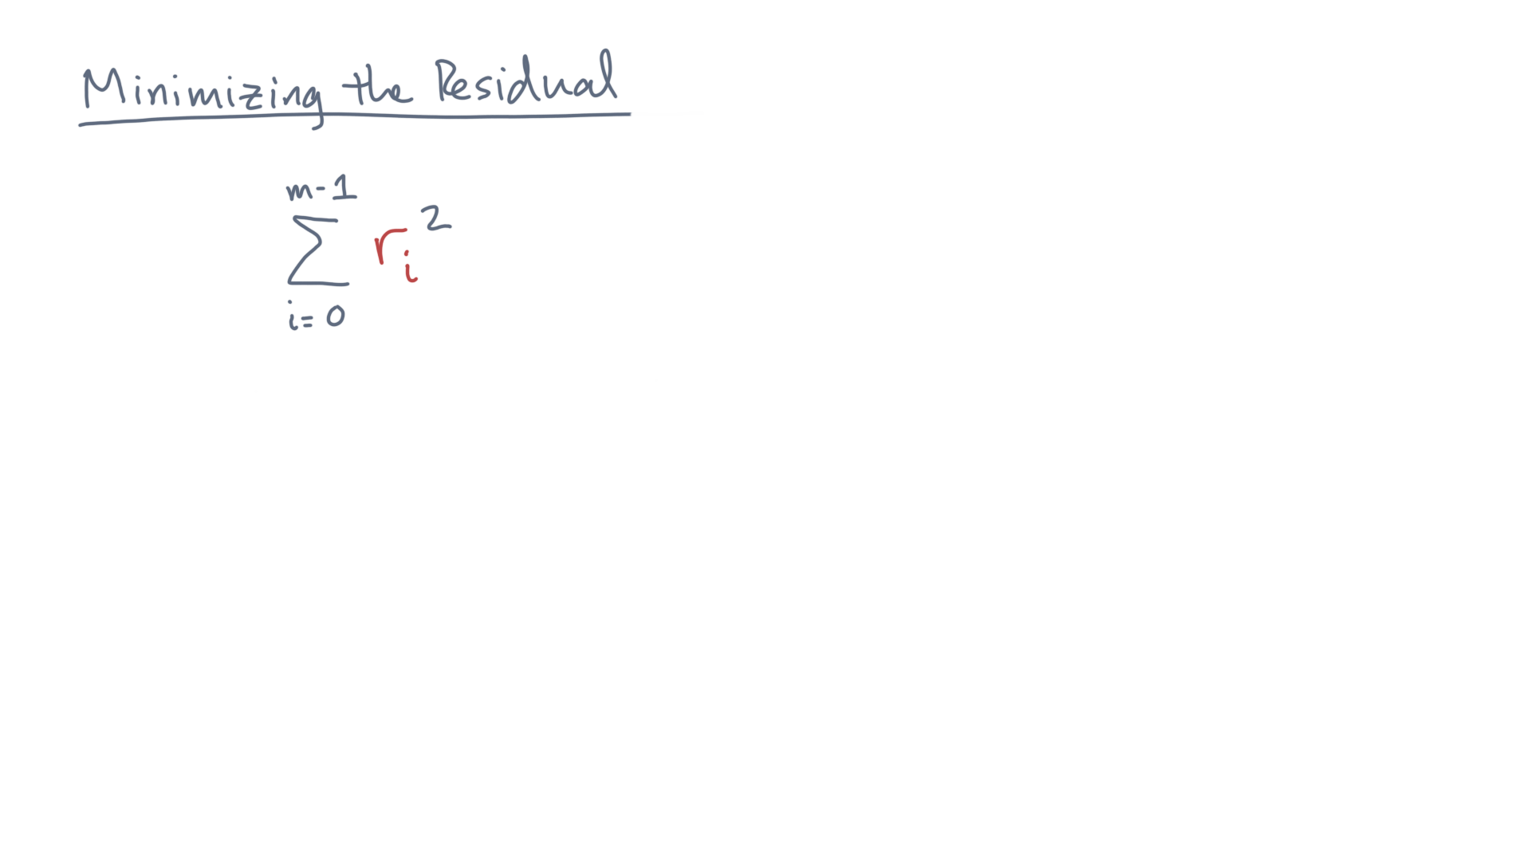
Notes:
So let’s return to the original problem, which was minimizing the sum-of-squared residuals.

Slide 21
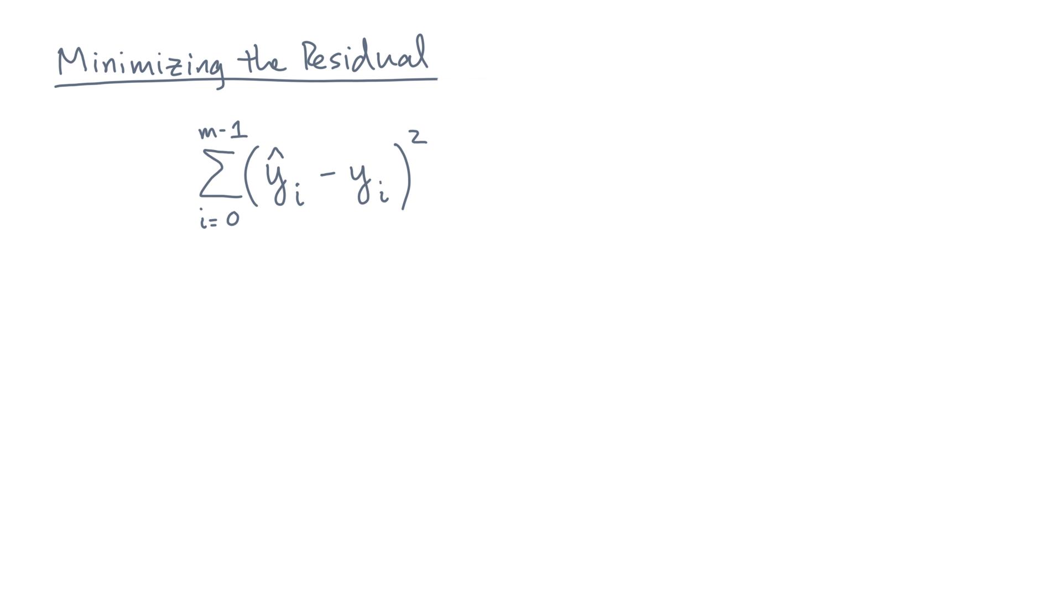
Notes:
The residual r-eye is, you’ll recall, the predicted response y-eye-hat minus the observed response y-eye.
The predicted response comes from the model, so substitute that.

Slide 22
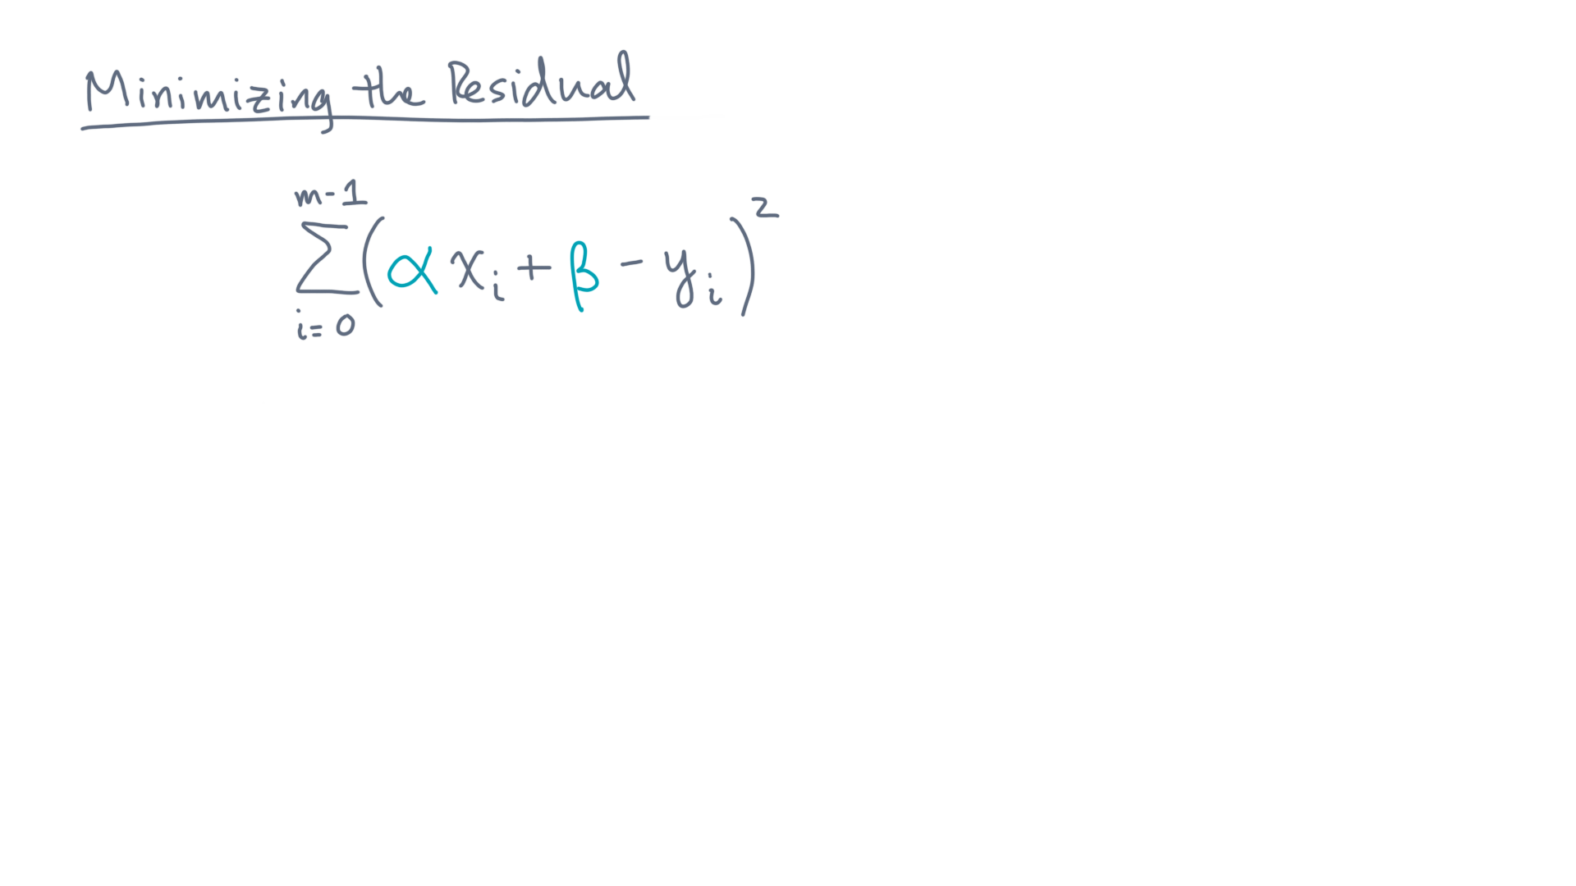
Notes:
So that’s alpha times x-eye plus beta.
Now we want to choose alpha and beta to minimize this sum.

Slide 23
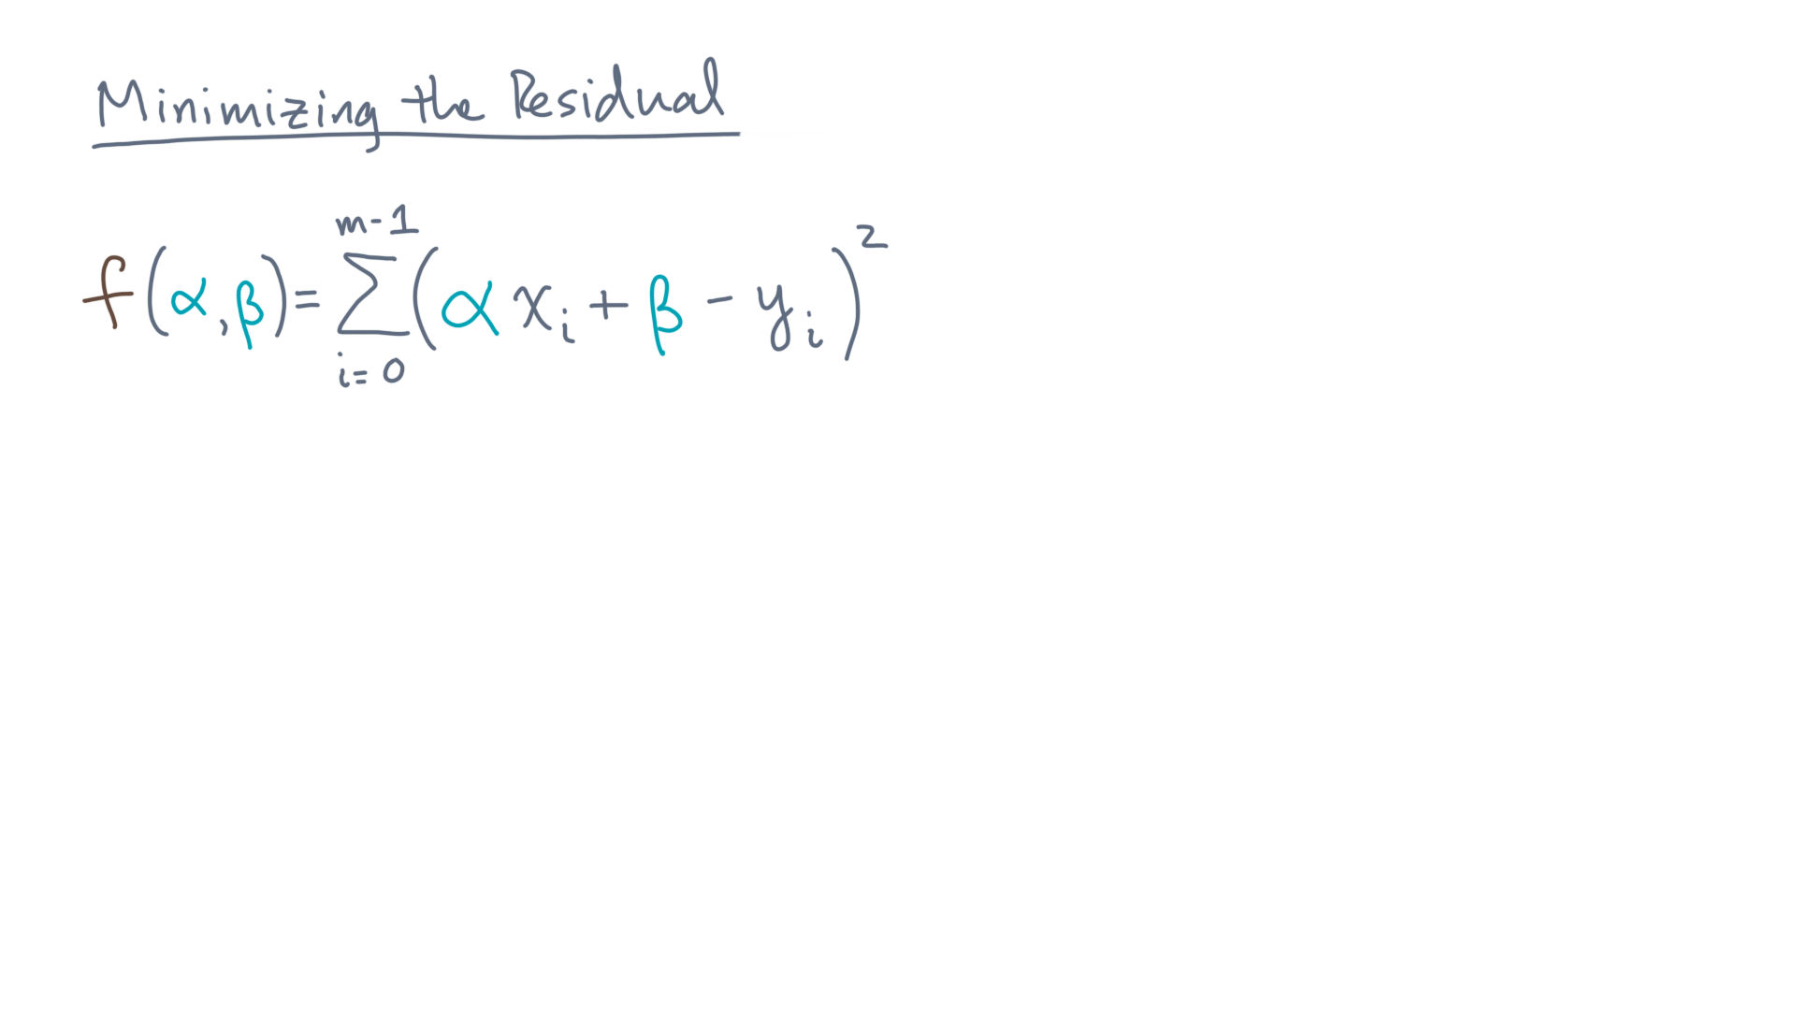
Notes:
So the function we want to minimize, or the *objective function*, is f of alpha and beta.

Slide 24
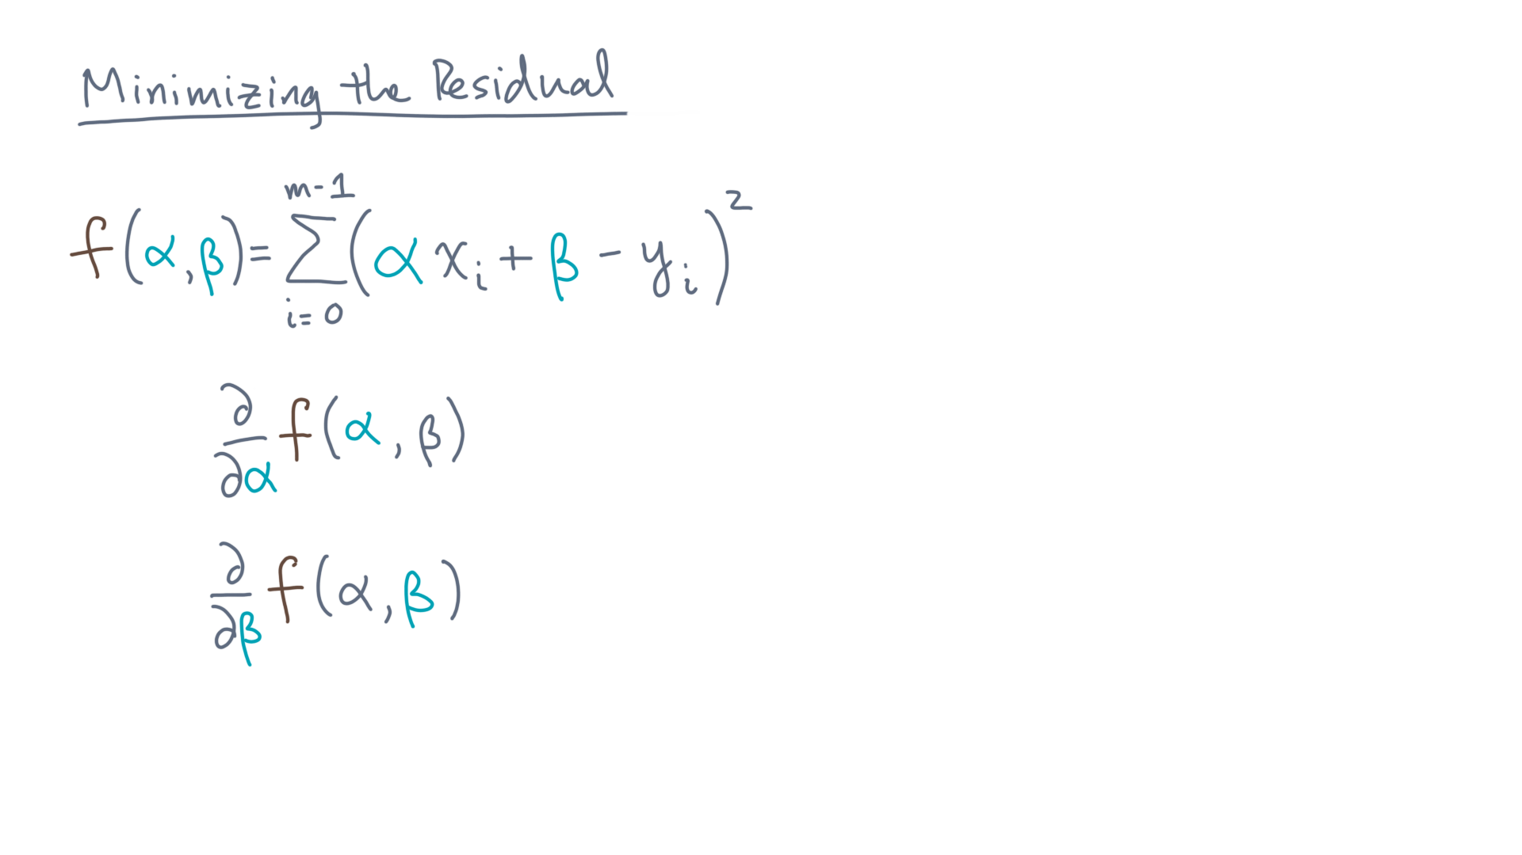
Notes:
To minimize a multivariate function like this one, you need to consider the partial first-derivatives of the function with respect to each variable.

Slide 25
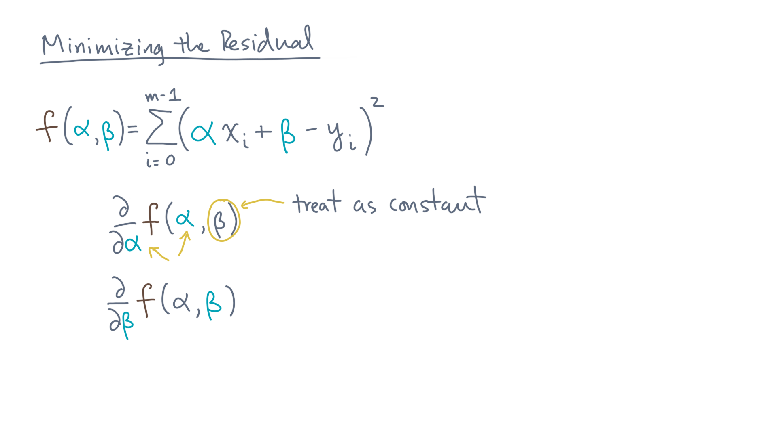
Notes:
You compute that just like an ordinary derivative, treating all other variables as constants.

Slide 26
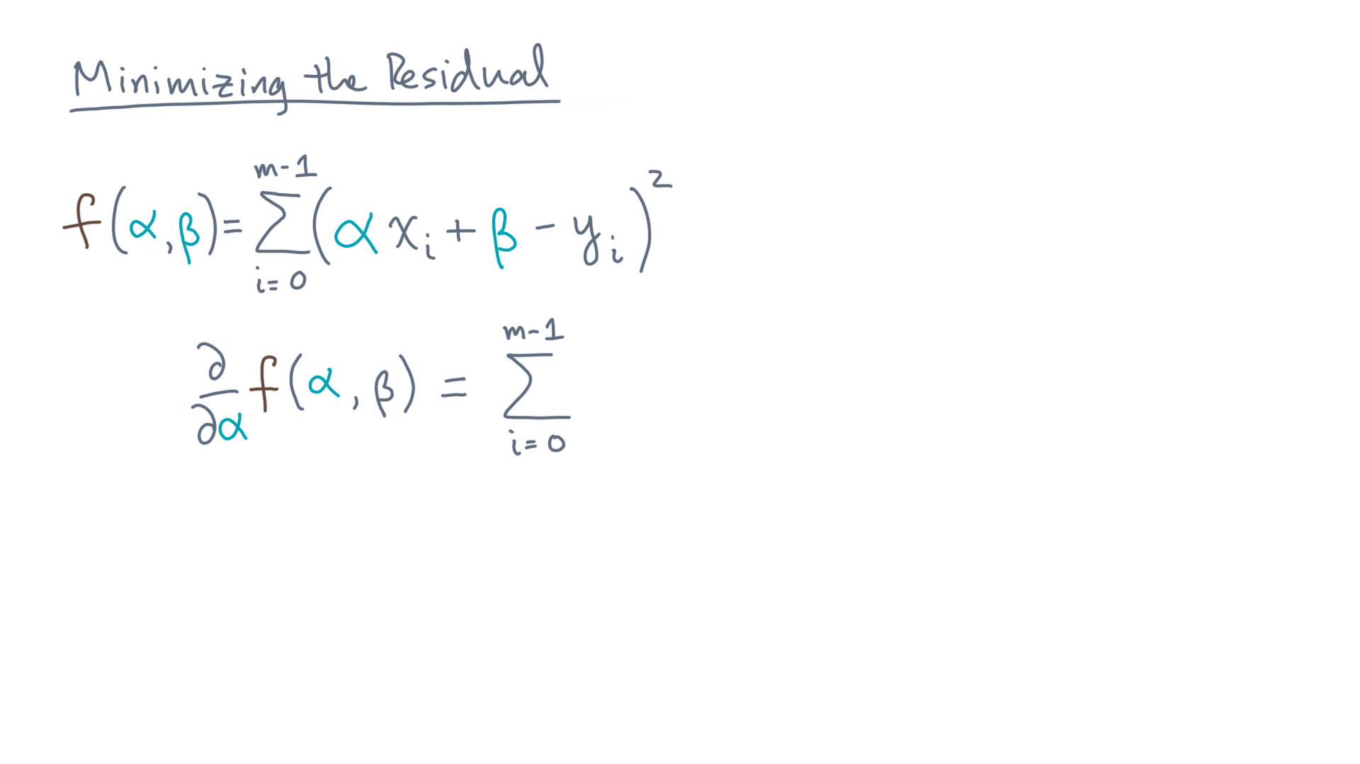
Notes:
Let’s start with alpha.

Slide 27
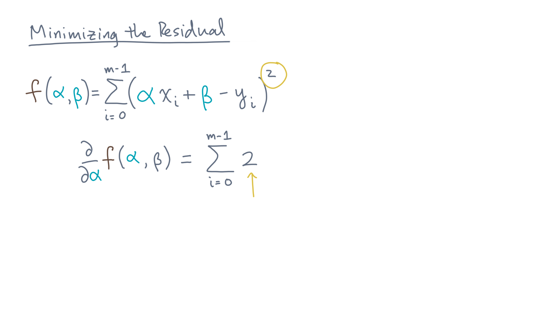
Notes:
You get two times …

Slide 28
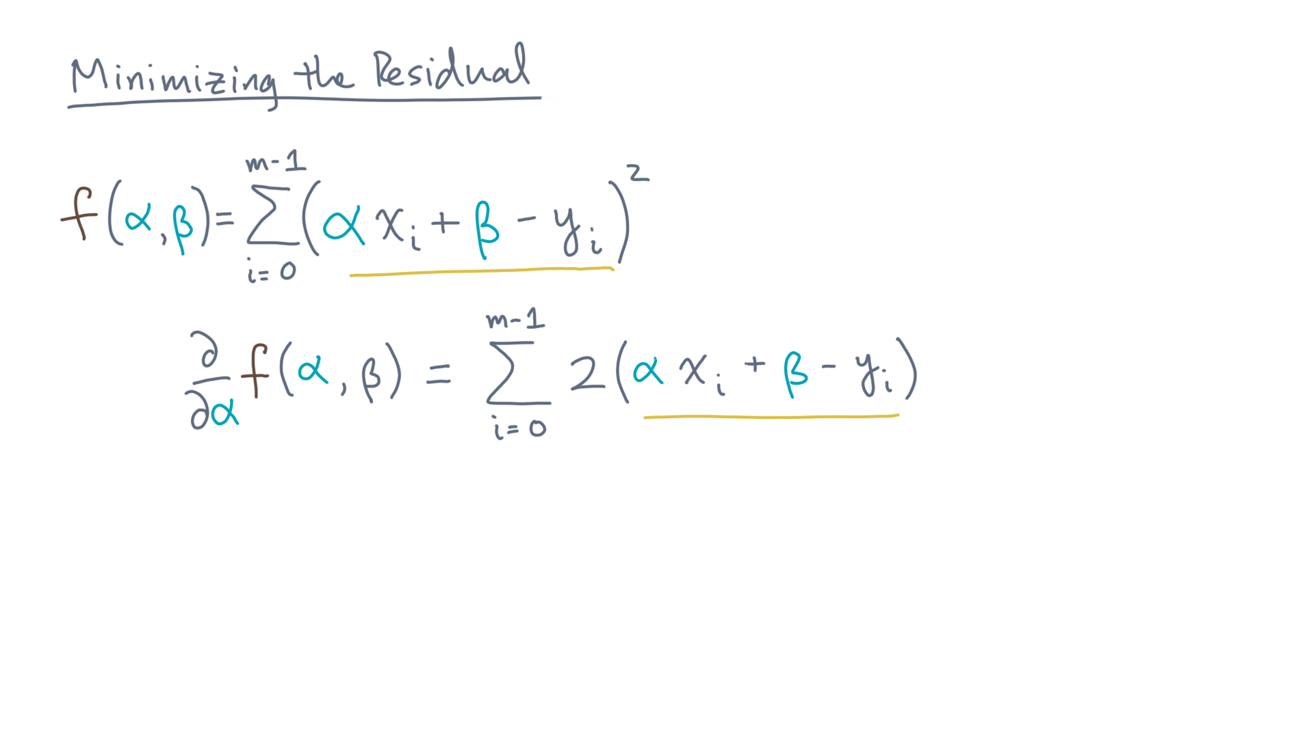
Notes:
… the quantity alpha times x-eye plus beta minus y-eye …

Slide 29
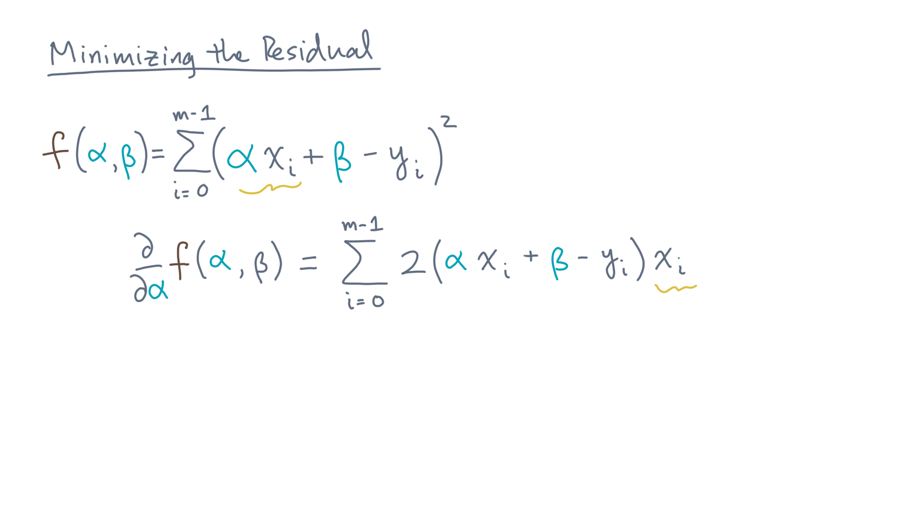
Notes:
… times x-eye.

Slide 30
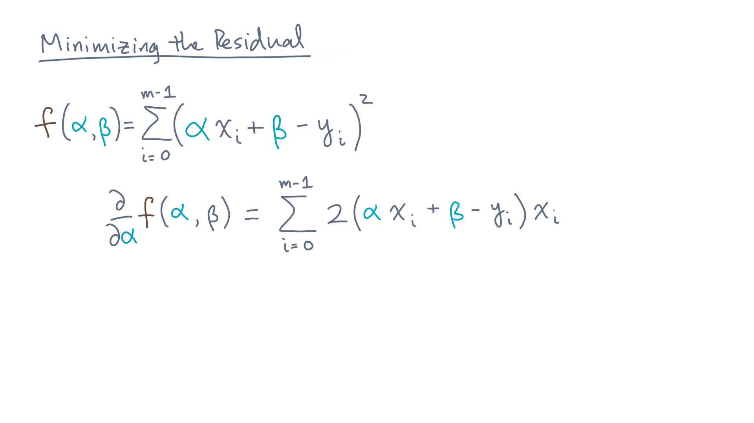
Notes:
Let’s rewrite that a little, distributing the x-eye.

Slide 31
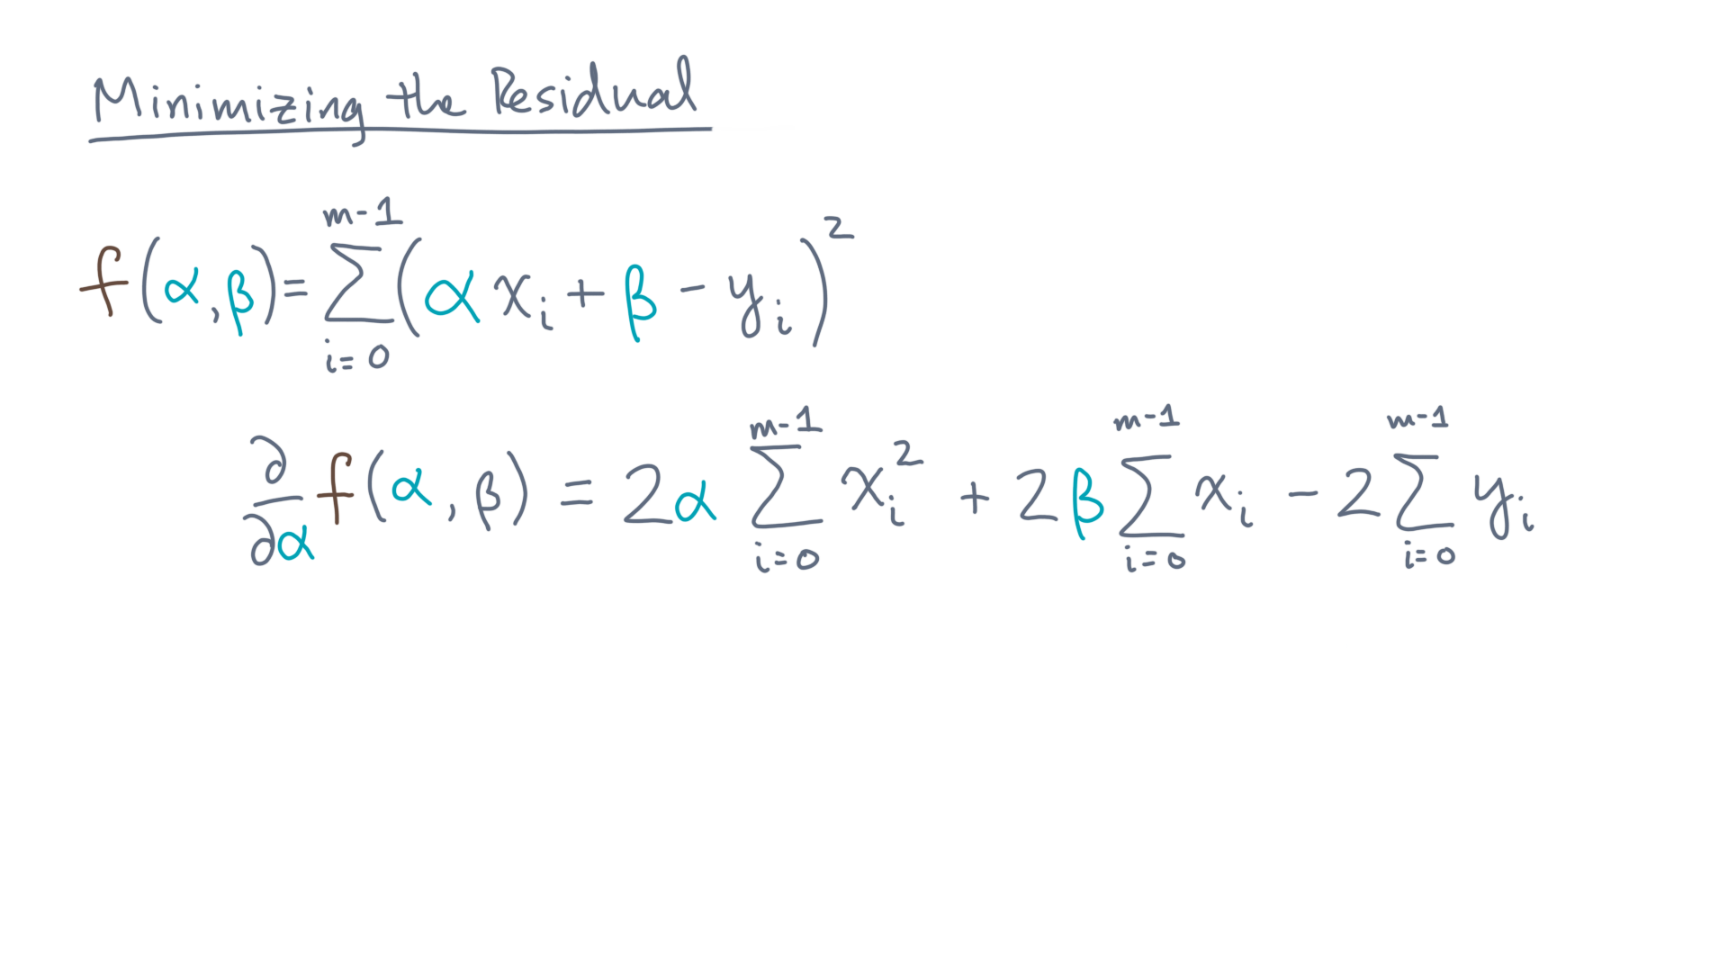
Notes:
This is the result.
Let’s simplify this formula further.

Slide 32
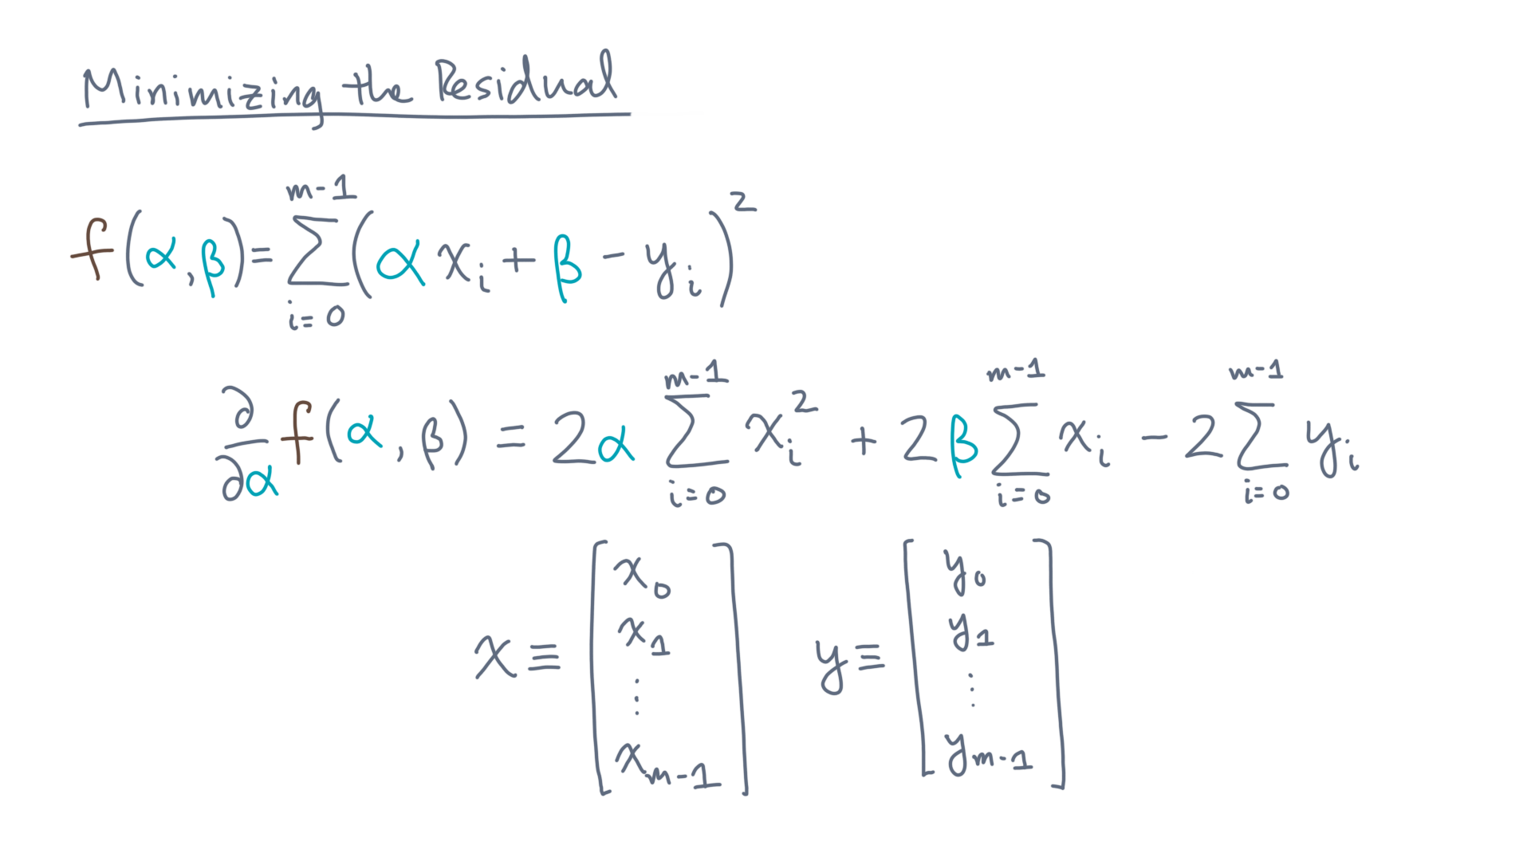
Notes:
First, stack the predictor values into a column vector, x, and do the same thing for the responses, y.

Slide 33
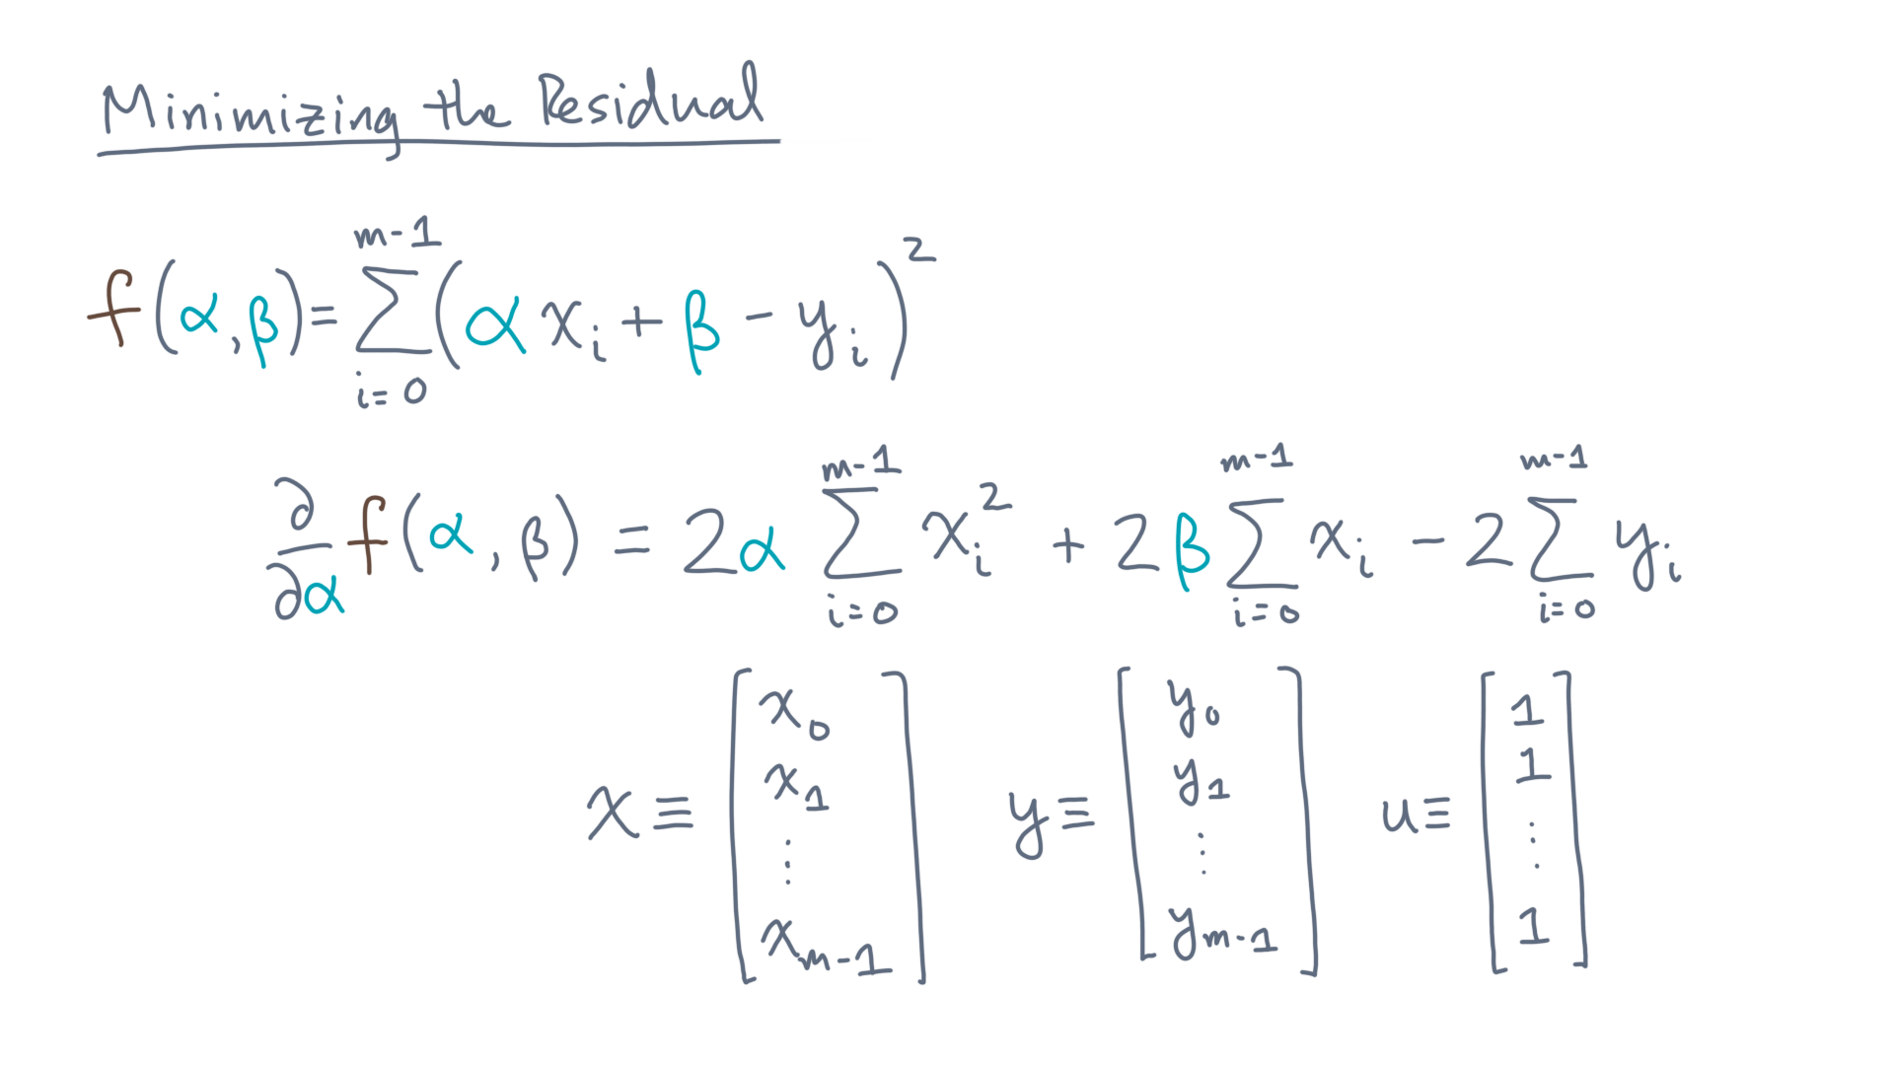
Notes:
And let “u” be a vector of all ones.
Then the sum simplifies to the following:

Slide 34
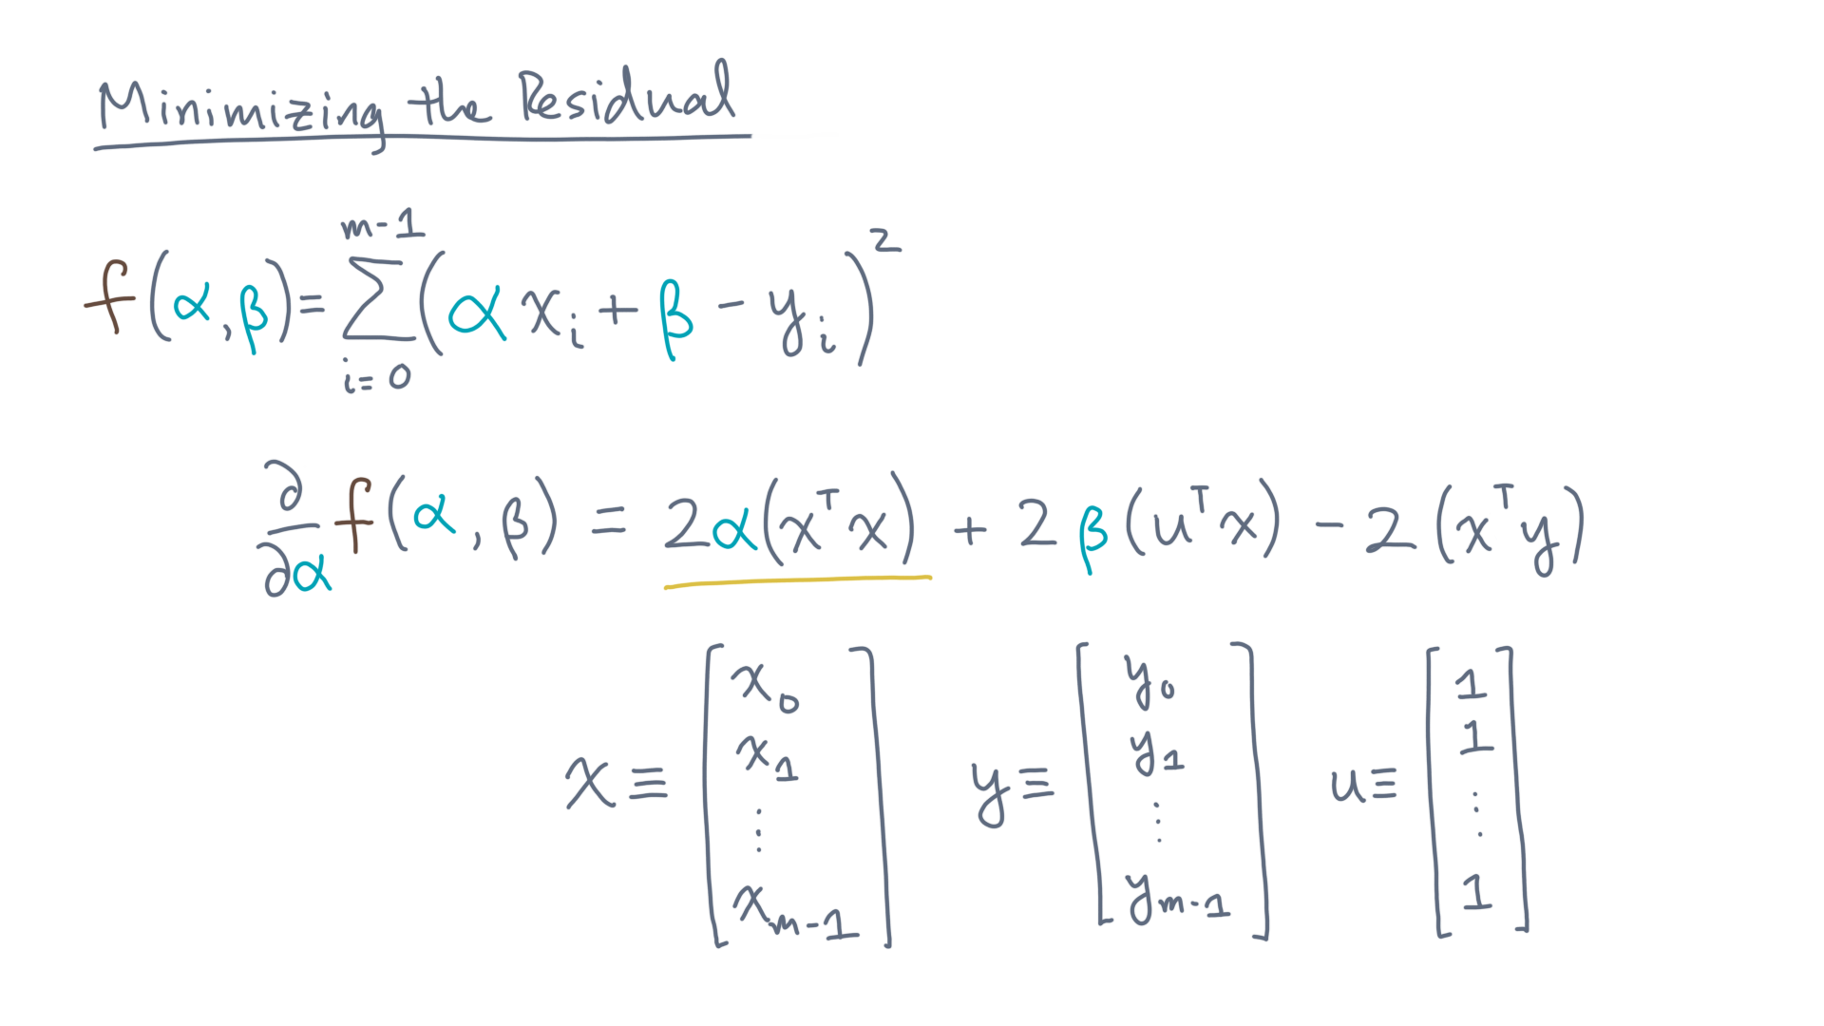
Notes:
Two times alpha times x-transpose-x …

Slide 35
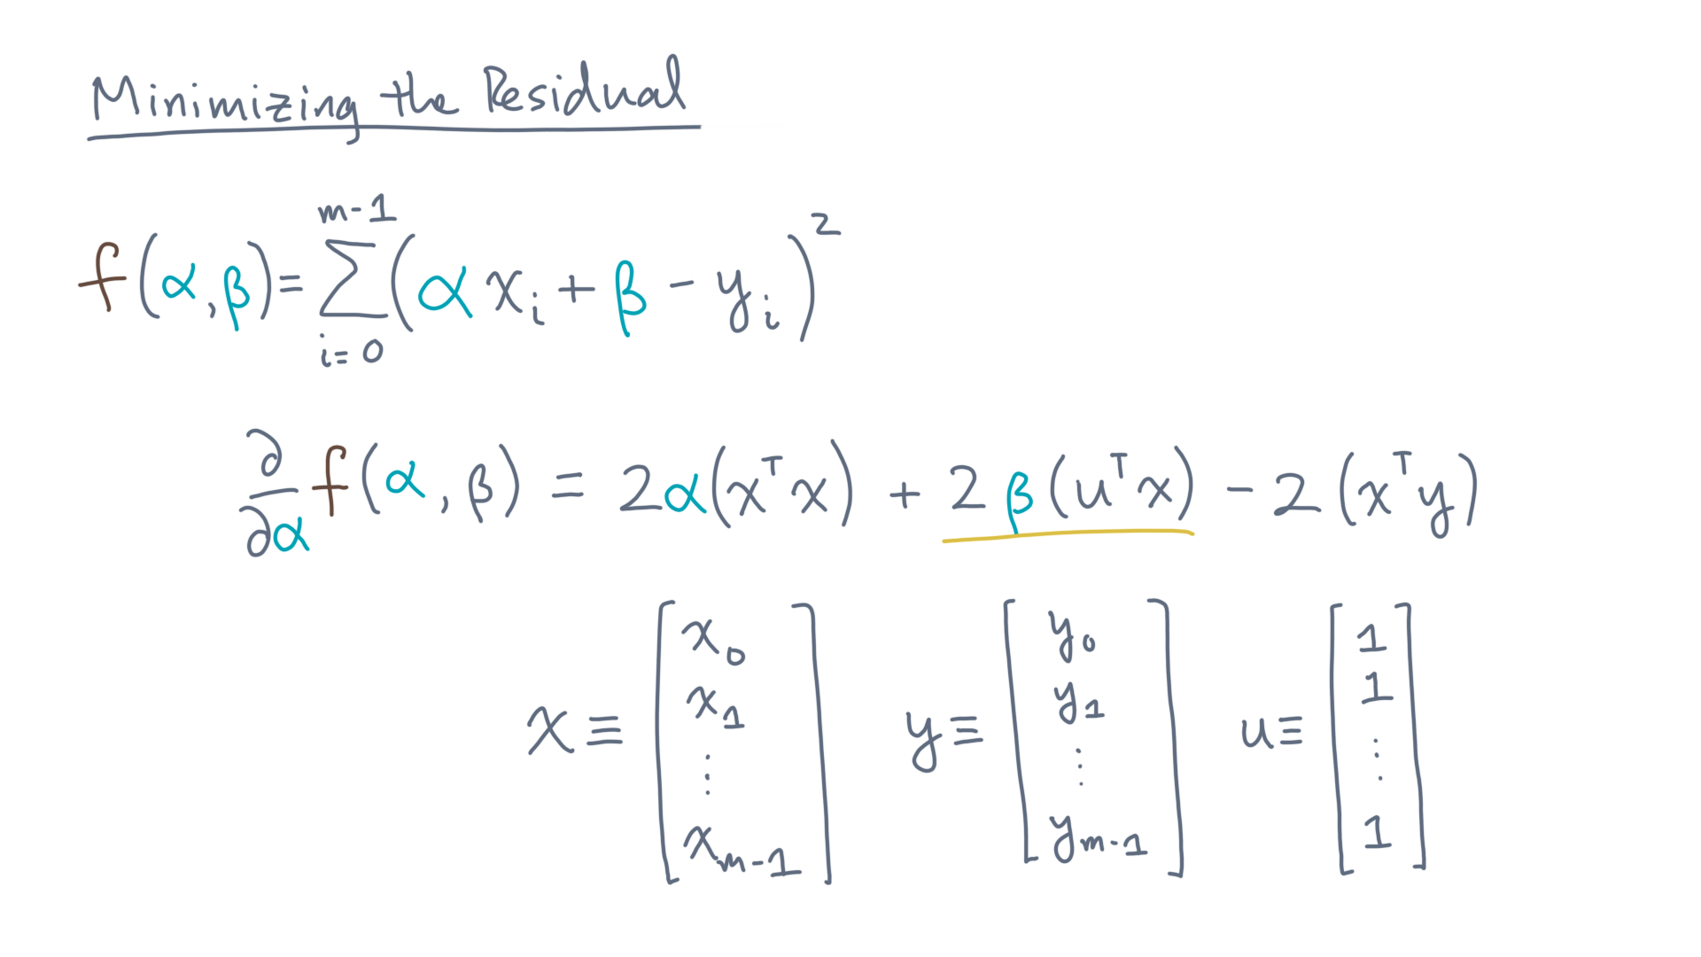
Notes:
… plus two times beta times u-transpose-x …

Slide 36
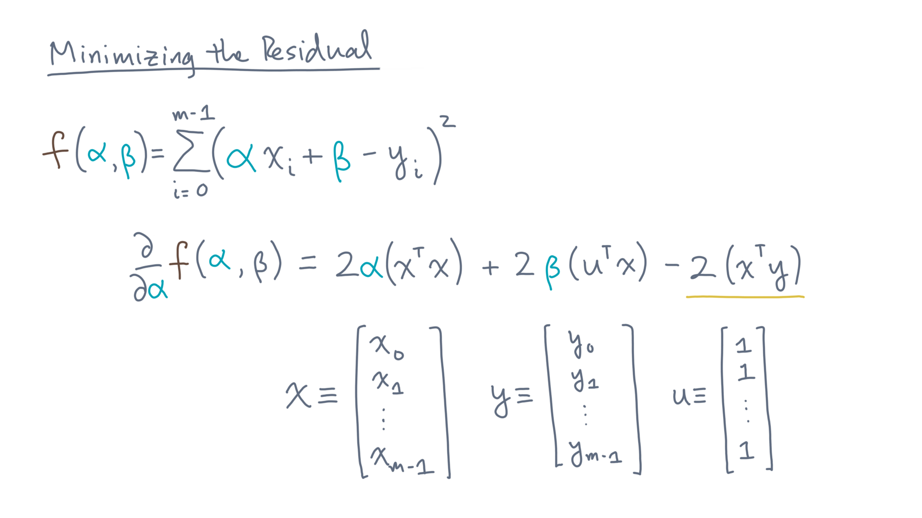
Notes:
… minus two times u-transpose-y.

Slide 37
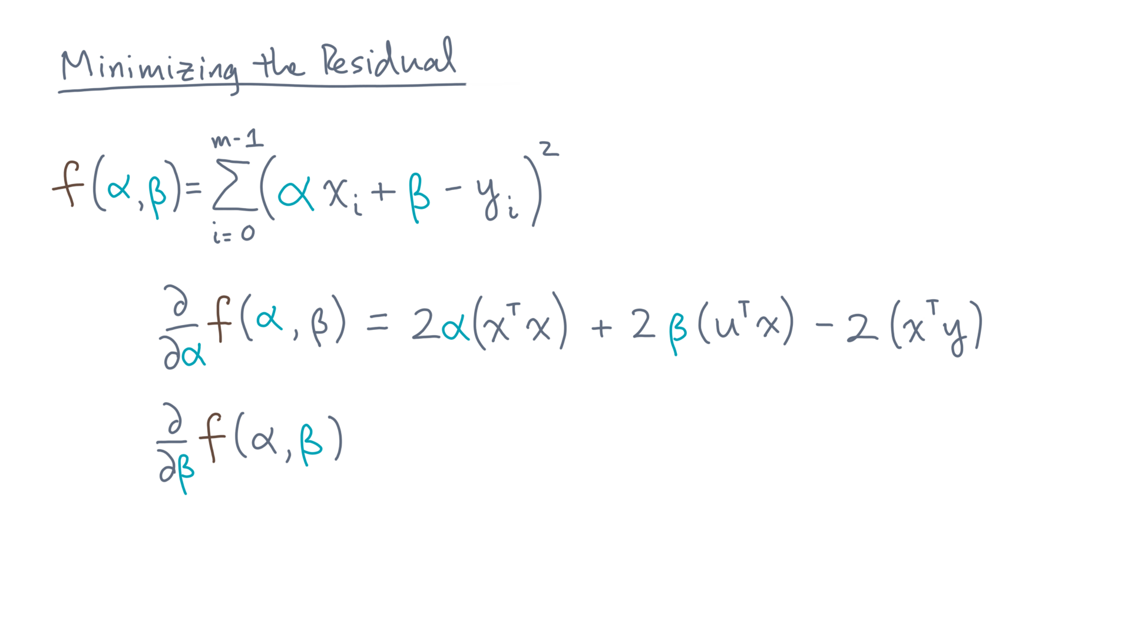
Notes:
You can repeat the same exercise for the partial first-derivative with respect to beta.
You should get the following:

Slide 38
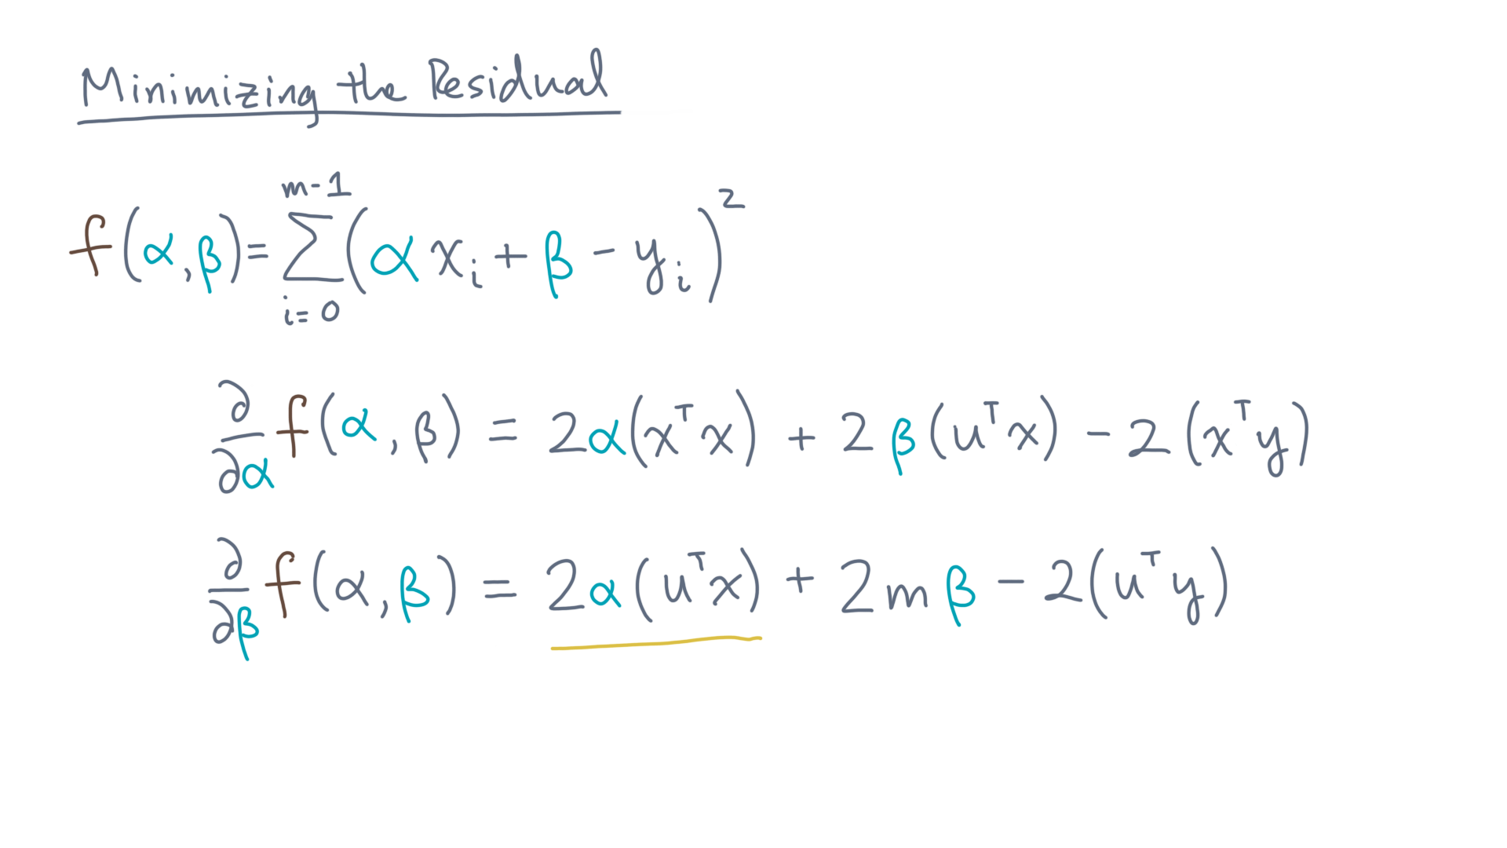
Notes:
Two times alpha times u-transpose x …

Slide 39
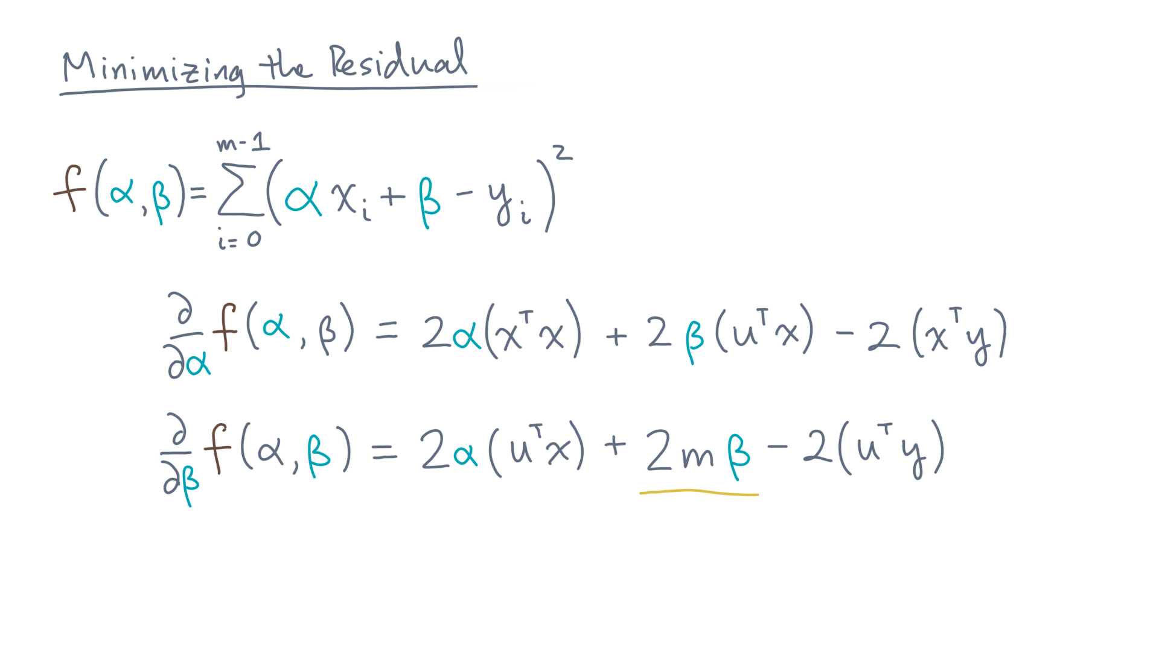
Notes:
… plus two times m times beta – and recall that “m” is the number of data points …

Slide 40
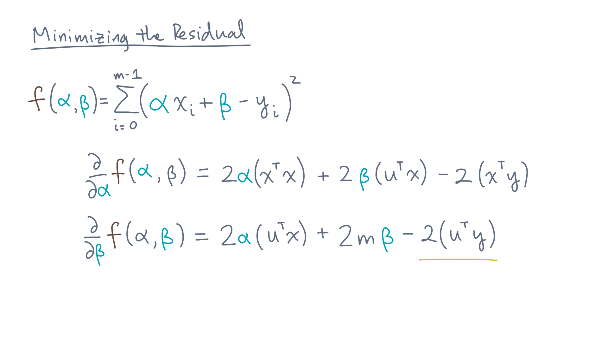
Notes:
… and finally, minus two times u-transpose-y

Slide 41
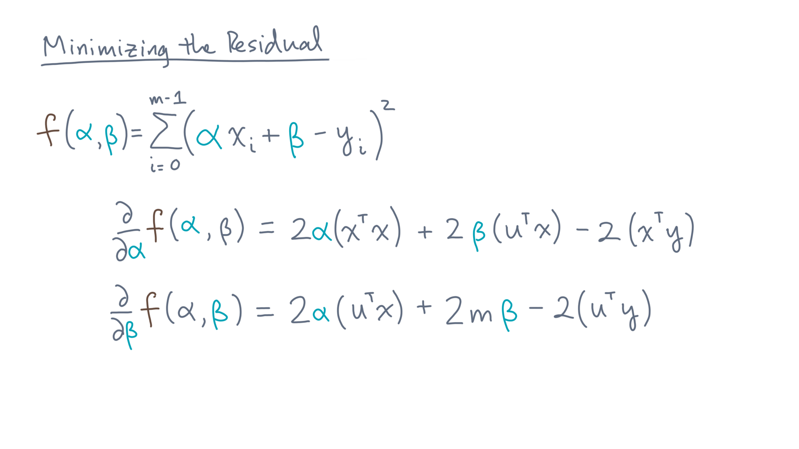
Notes:
Now recall what happens at the extreme points.

Slide 42
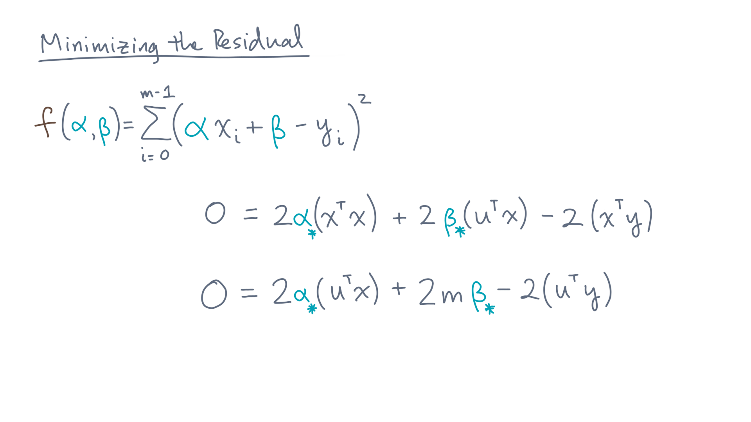
Notes:
The first derivatives must be zero.

Slide 43
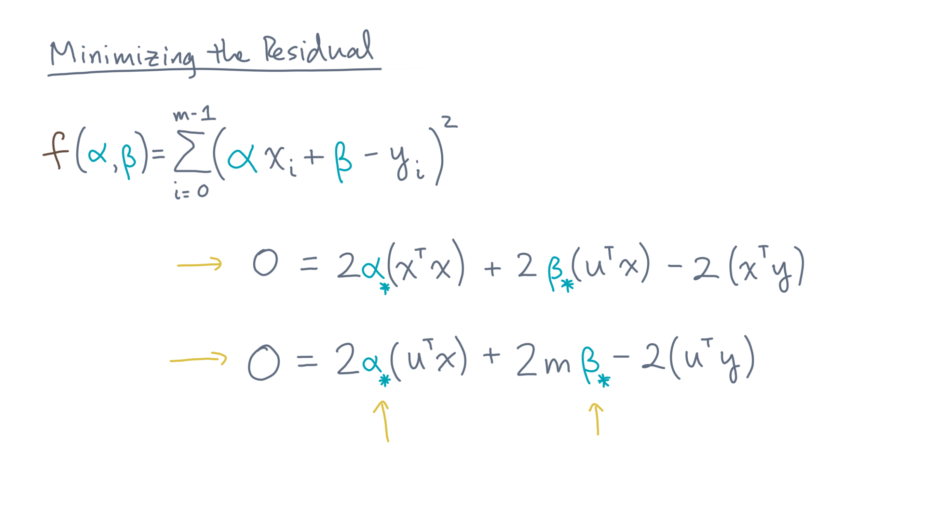
Notes:
This is a system of two equations in two unknowns.
Solving them, you’ll find:

Slide 44
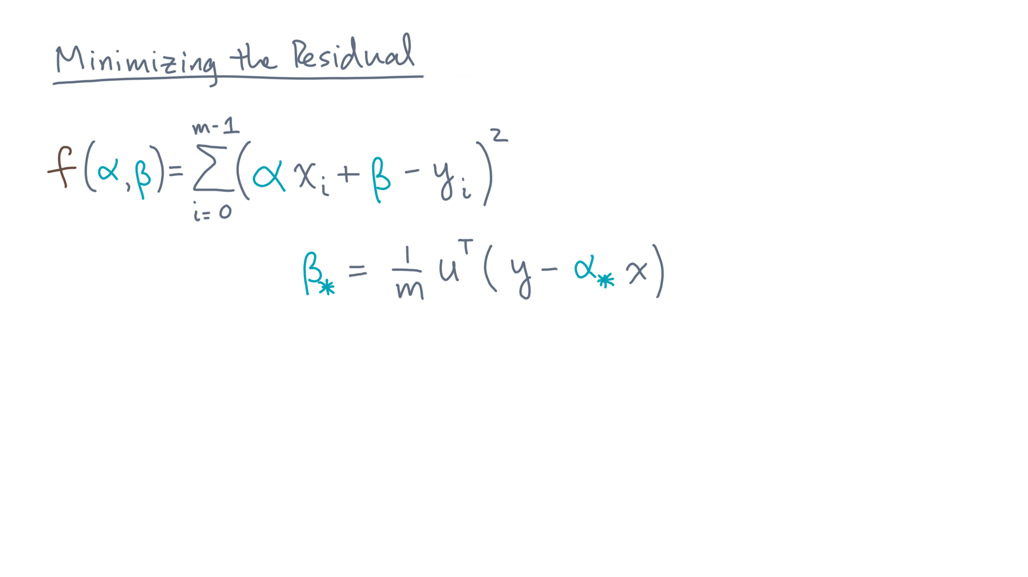
Notes:
… beta-star equals one over m times u-transpose times the quantity y minus alpha-star x …
And for alpha-star:

Slide 45
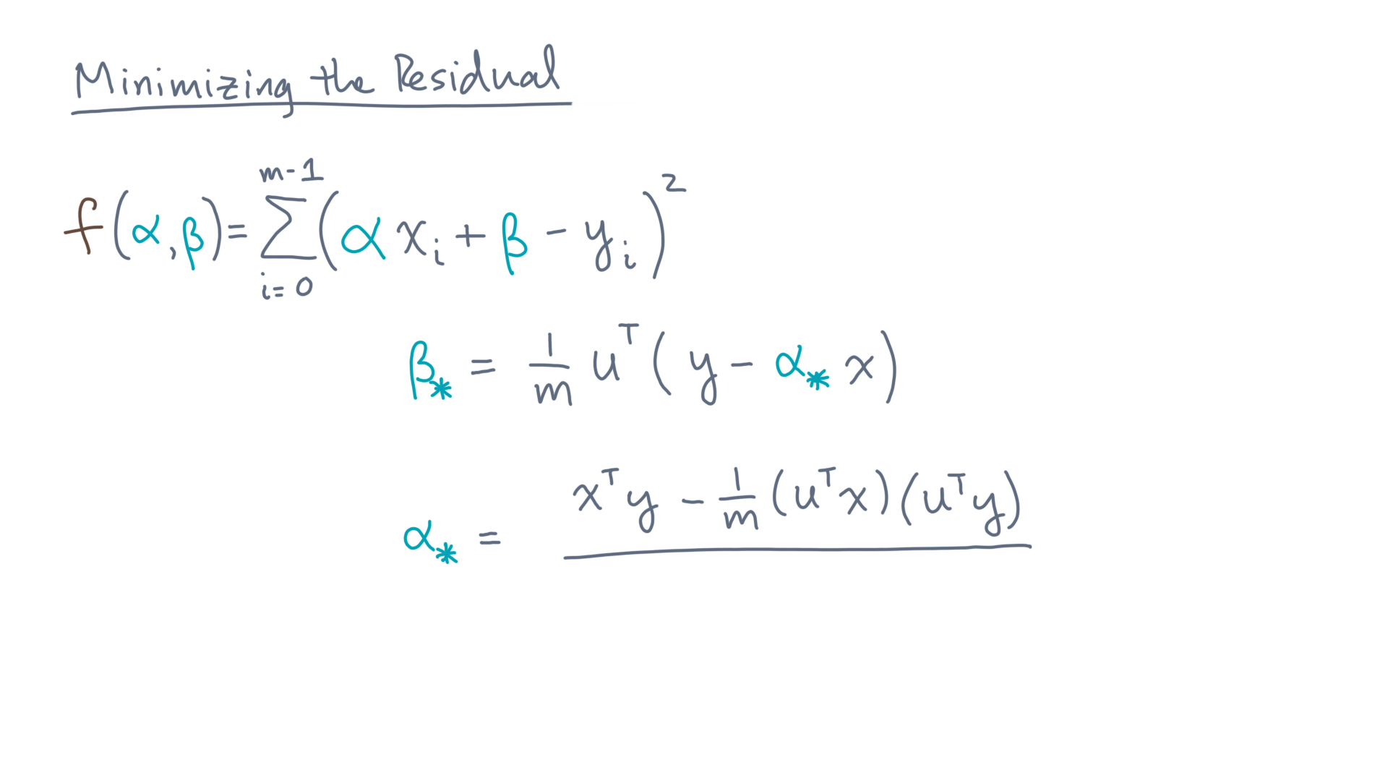
Notes:
It’s a ratio.
The numerator is x-transpose y minus one over m times u-transpose-x times u-transpose-y.

Slide 46
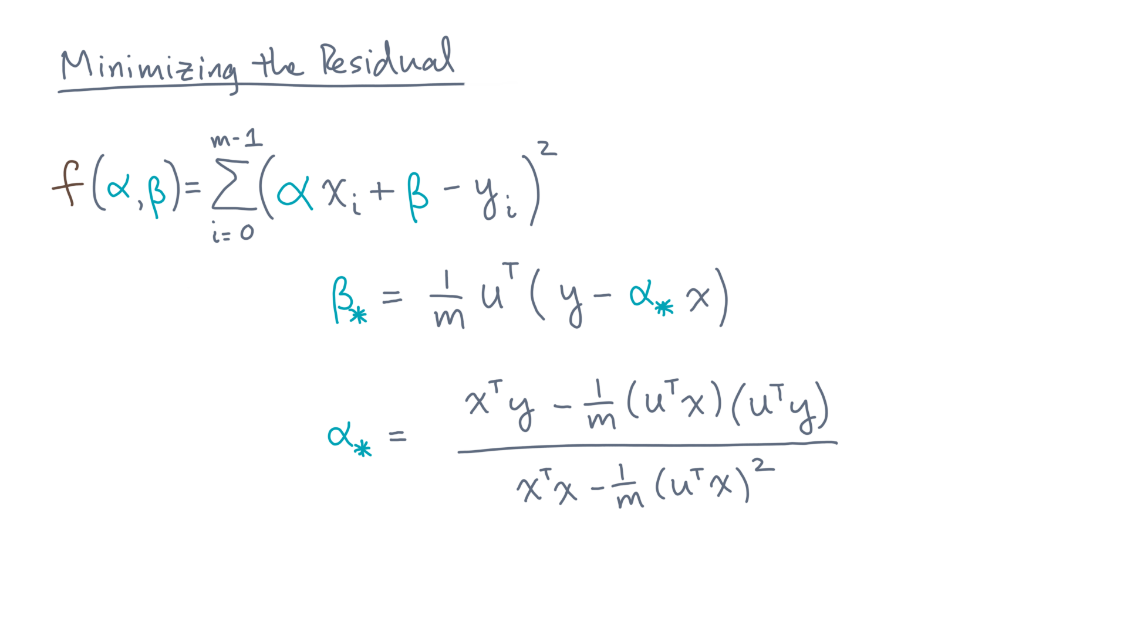
Notes:
And the denominator is x-transpose-x minus one-over-m times u-transpose-x, squared.
As a sanity check, let’s go back to the sample data from the previous lesson and see what the fit produces.

Slide 47
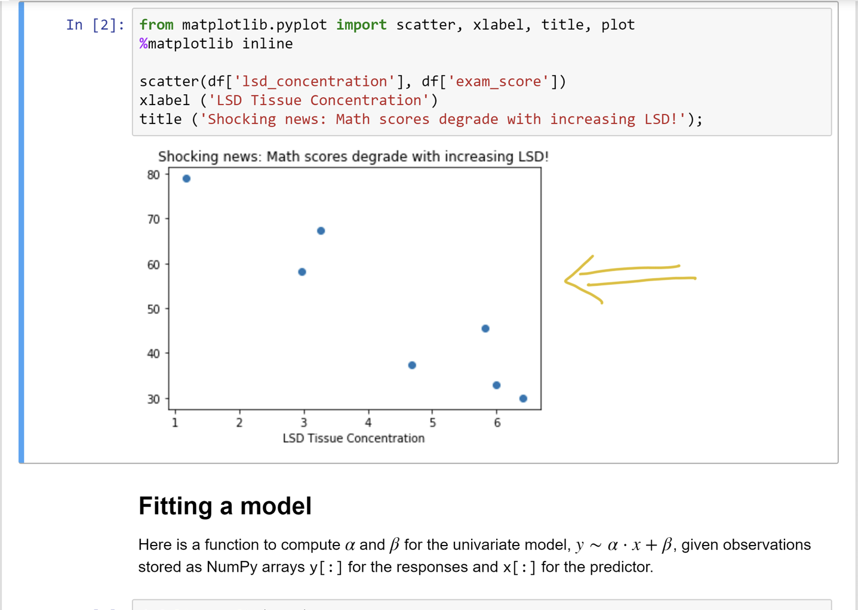
Notes:
Recall this dataset from a earlier lesson.

Slide 48
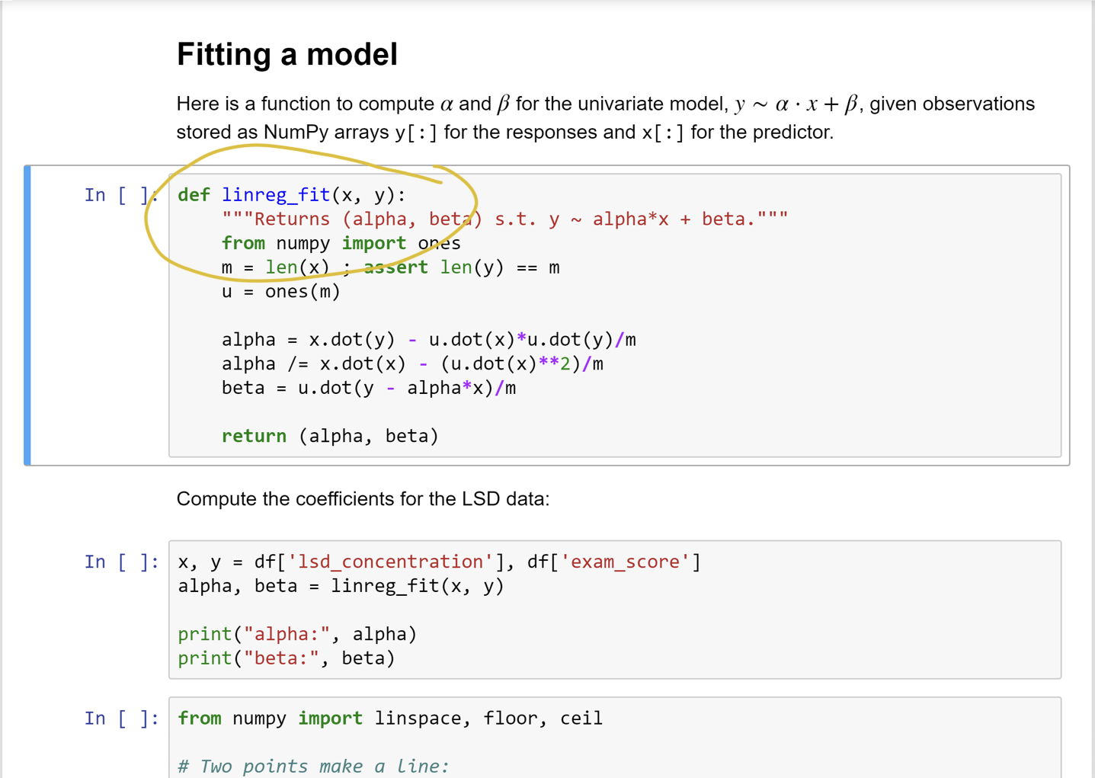
Notes:
Let’s consider a Python function to fit a model to this data.

Slide 49
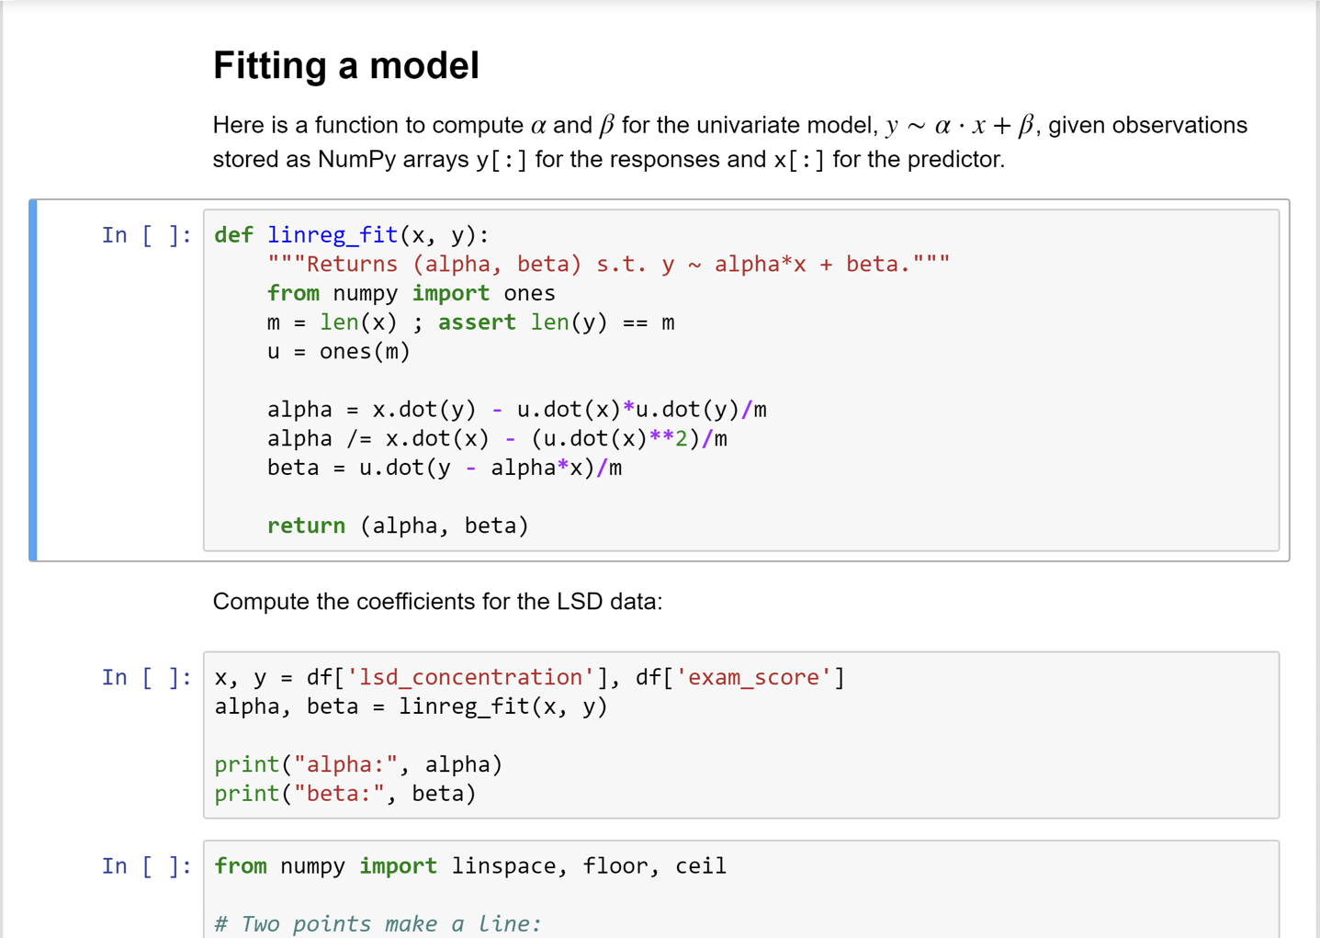
Notes:
You should take a moment to verify that it implements the formulas you just derived.

Slide 50
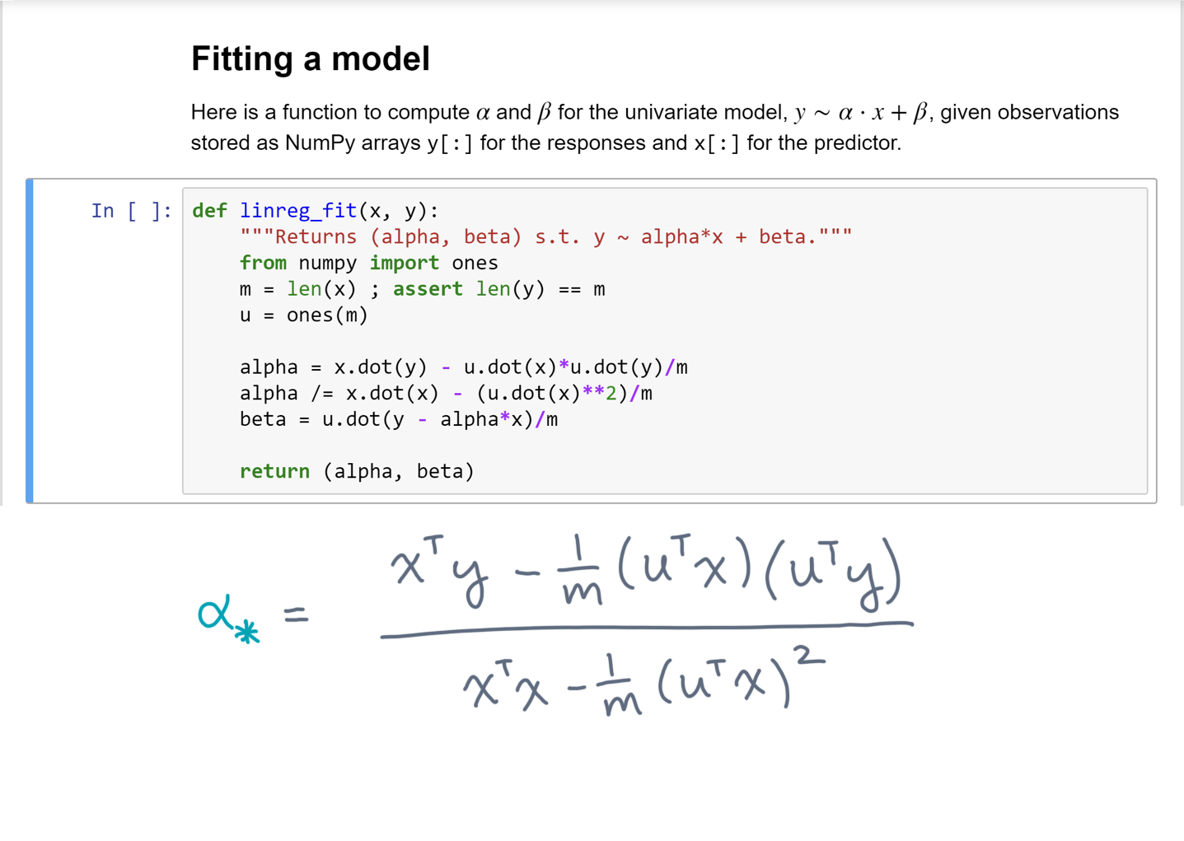
Notes:
For instance, recall the formula to compute alpha star.

Slide 51
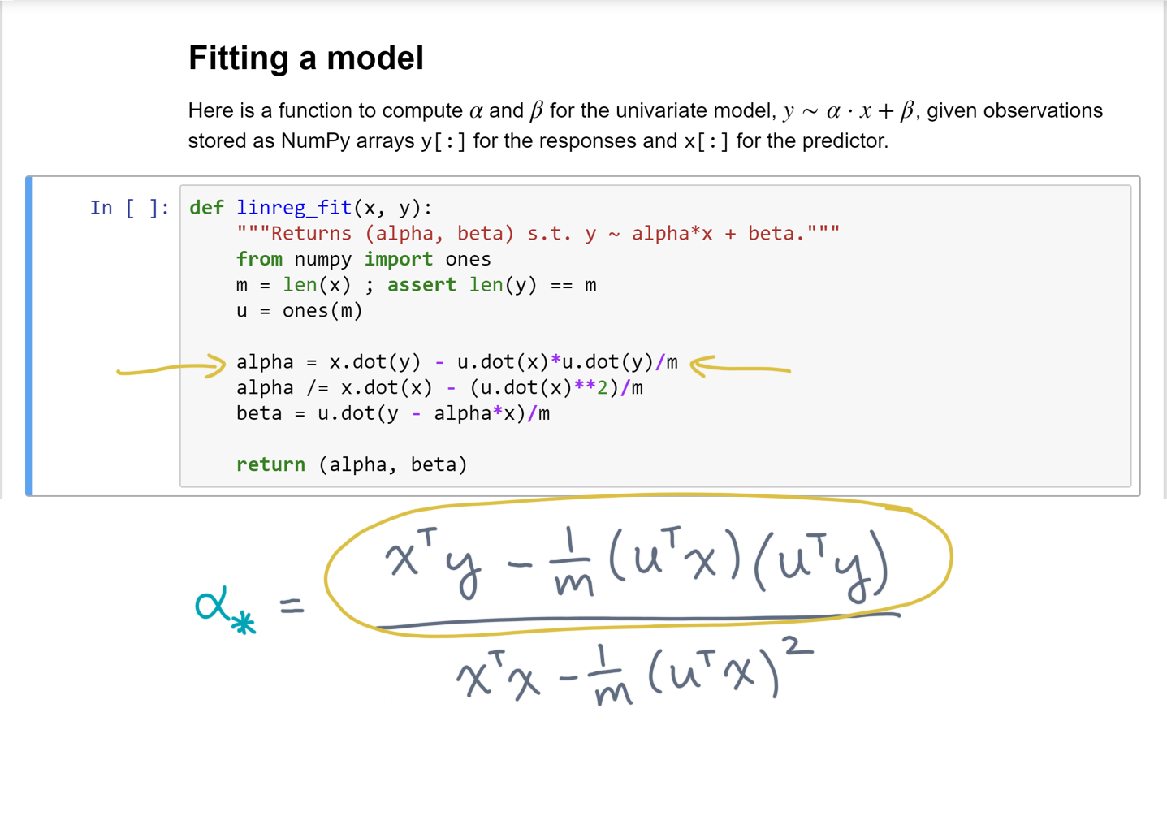
Notes:
The numerator maps to this first statement.t

Slide 52
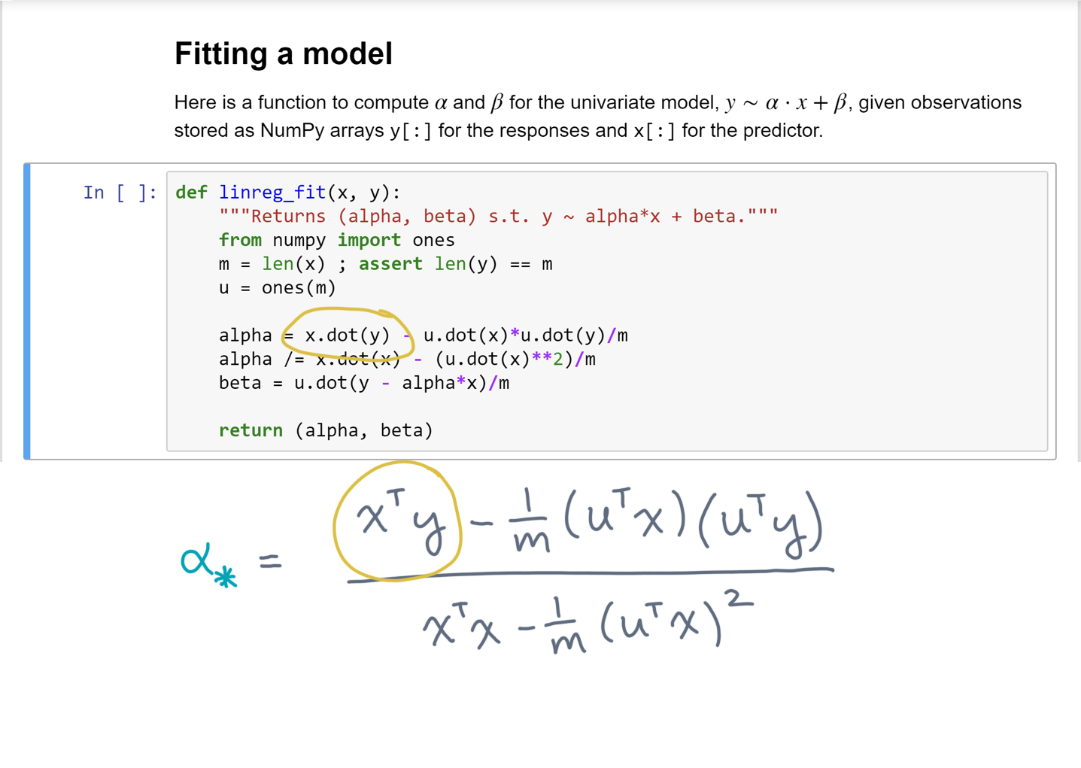
Notes:
X-transpose-y appears in the code as x dot y.

Slide 53

Notes:
Returning to the notebook, let’s run the next code cell, which performs the fit and prints the coefficients.

Slide 54

Notes:
And here is the result.
Now there’s another code cell below, which will add a line for this model to the original scatter plot.

Slide 55

Notes:
And you can see that it’s a pretty reasonable fit!

Slide 56
Notes:
So, that was easy!
Let’s quickly recap what you just did.

Slide 57
Notes:
You started with the linear regression problem, which in turn was formulated as an mathematical optimization problem.
Namely, to find the model parameters that minimize the sum-of-squared residuals.
With a little calculus and algebra, you were able to derive deterministic formulas for those parameters.

Slide 58
Notes:
Now, what you’ve done so far is limited to the case of a single predictor.
So when you are return, we’ll extend the formulation so far to handle multiple predictors, which is the multiple linear regression problem.

